Slide 1



SeRaNDiP - Leveraging Inherent Sensor Random Noise for Differential Privacy Preservation in Wearable Community Sensing Applications
AYANGA IMESHA KUMARI KALUPAHANA
ANANTA NARAYANAN BALAJI
XIAOKUI XIAO
LI-SHIUAN PEH
National University of Singapore, Singapore
Notes:
Hellow !! I am Ayanga Kalupahana from National University of Singapore. I am going to present our research, Serandip-Leveraging Inherent Sensor Random Noise for Differential Privacy Preservation in Community Sensing Applications. 30s

Slide 2
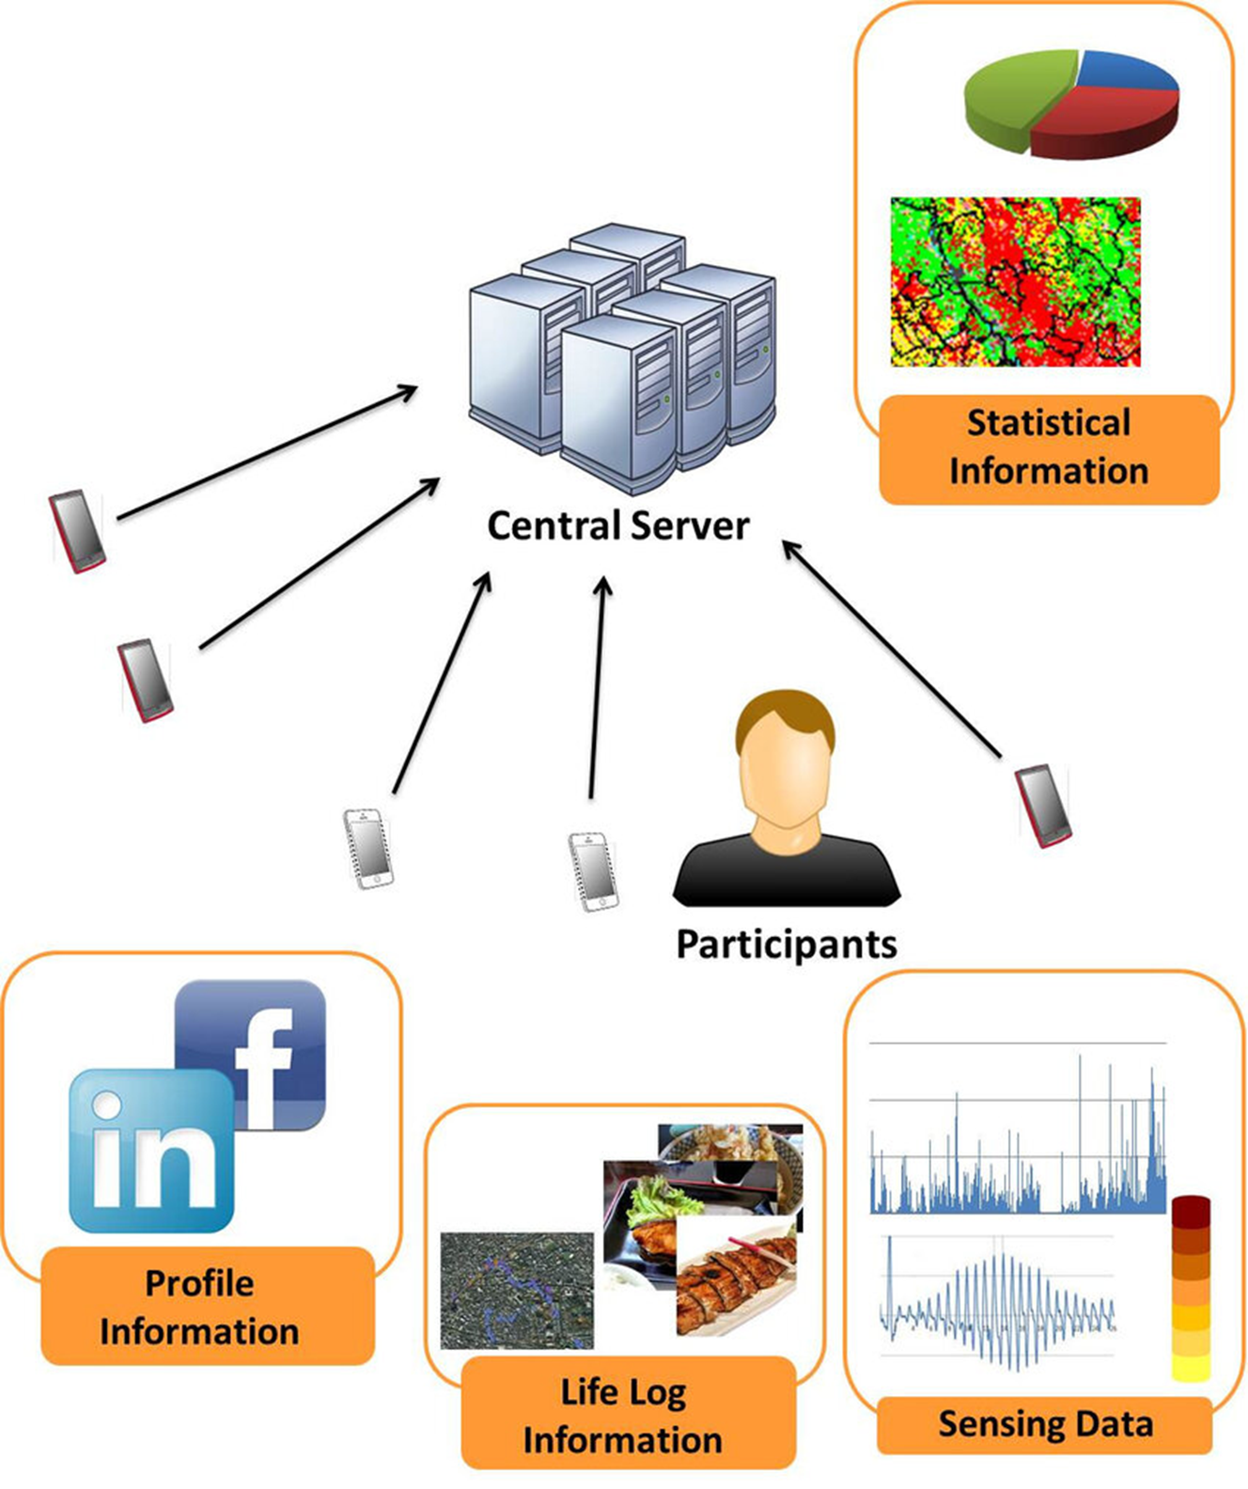
Wearable community sensing
Provides analysis on community not individuals based on wearable devices' inputs
Data Aggregator
Source : Negative Surveys with Randomized Response Techniques for Privacy-Aware Participatory Sensing (researchgate.net)
Notes:
Aggregated analysis on community based on wearable devices' input data.
There is no any analysis targeting individuals.
Participants update their data from their personal devices like smart phones
Participants' data can be anything thing from profile information to sensing data.
In our research, we are considering sensor data-based wearable community sensing applications.
1min 15s

Slide 3
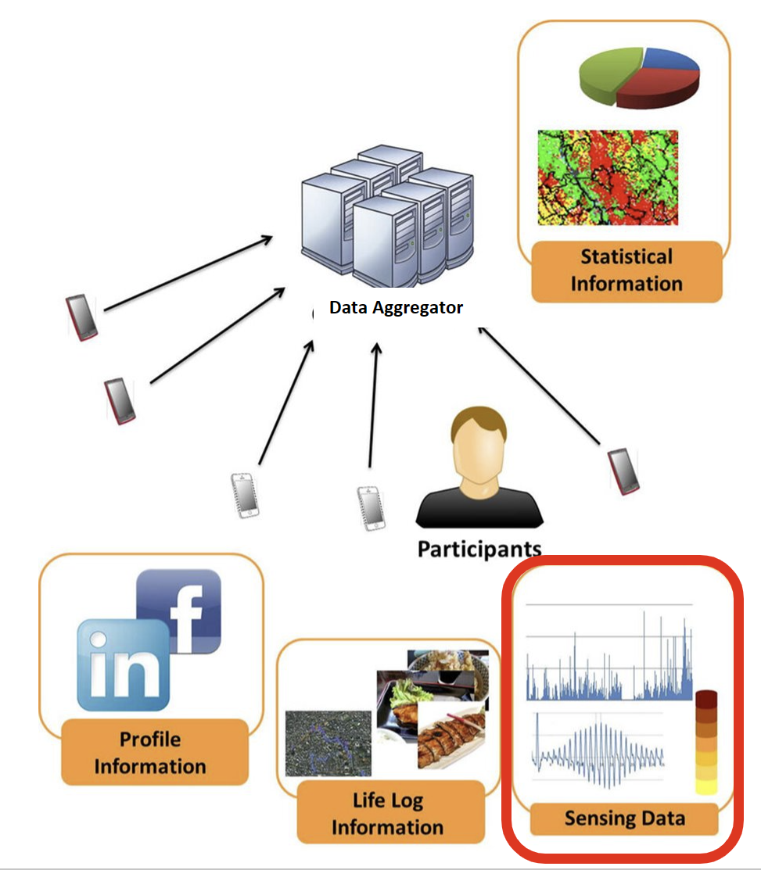
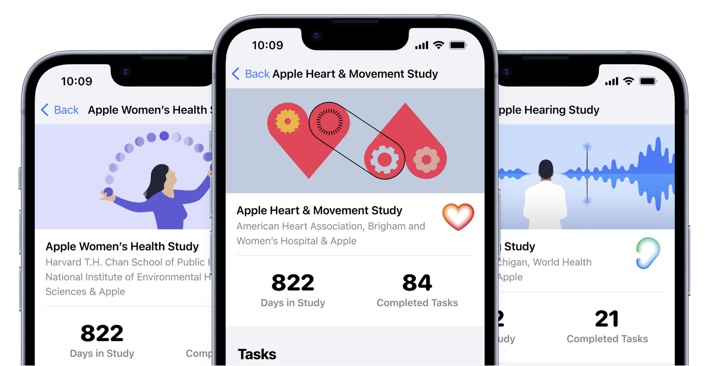
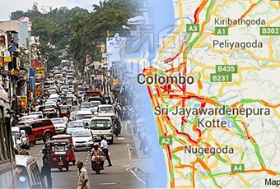






Sensor input based wearable community sensing programs
Singapore's National Step Challenge
Over 910,000
Apple Research app
200,000 active participants
100 million active apple watch users
Google Map's Live Traffic
154.4 million monthly
participants
Notes:
There are numerous amount of sensor input-based wearable community sensing programs available with a higher amount of community participation at both global and national levels.
1:45
**************************************************************************************************************************************
For example, Google Map's Live traffic has 154.4 million monthly participants, Apple Research app has 2 hundred thousand active participants whereas there are 100 million active apple Watch users. Singapore's National step challenge has over 9 hundred thousand participants.

Slide 4
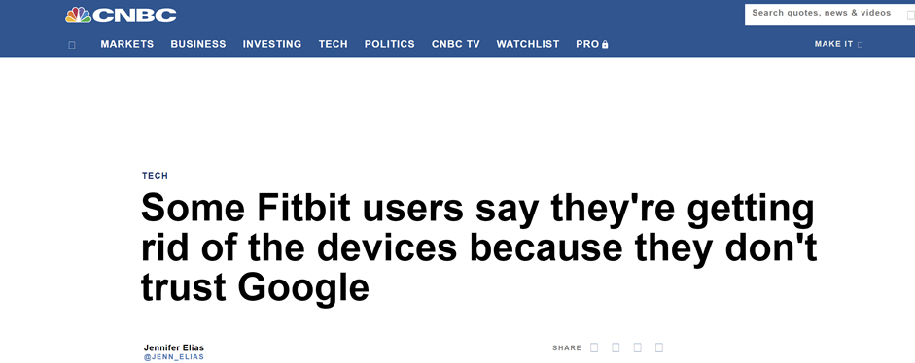

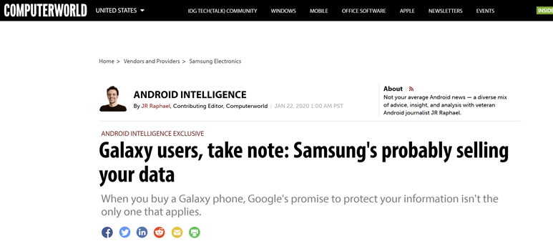

Privacy for community sensing
Data Aggregator
Notes:
But there were multiple news circulating on data leaks by data aggregators including tech giants.
Due to trust issues in data aggregator, privacy of participants must be a top-priority in community sensing.
********************************

Slide 5
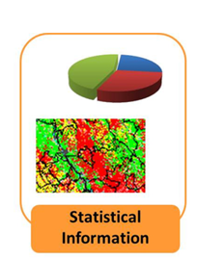
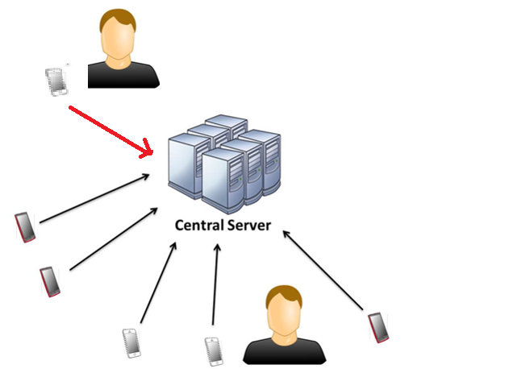
Differential Privacy (DP)
Statistical strong guarantee
The results would be similar whether an individual decides to be in or out
Data + Noise
Notes:
Differential privacy which provides statistical strong guarantee is a famous privacy mechanism used in community sensing.
Here the result would be similar whether an individual participant decides to be in the study or not.
This is achieved by adding statistical noise on data before sharing with data aggregator.
************************************
-in a case for further explanation---
It’s a mathematical promise between data curator and subject
Risk of affecting doesn’t change with participation
To have such no risk, data must be indistinguishable with other’s data.
Randomize in other words add noise.
So DP is noise.

Slide 6
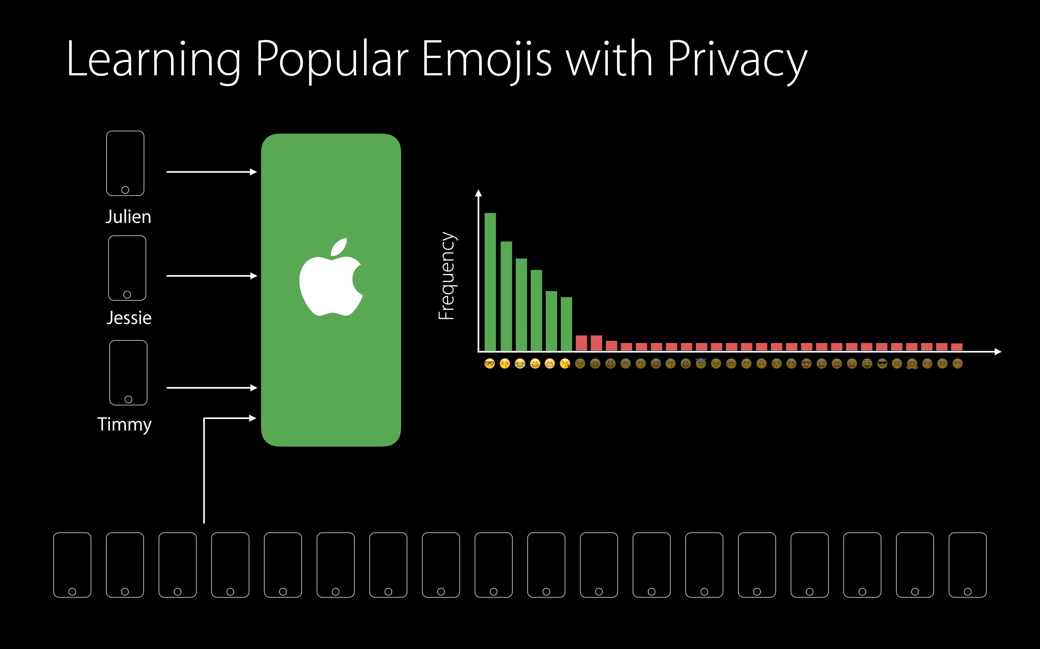
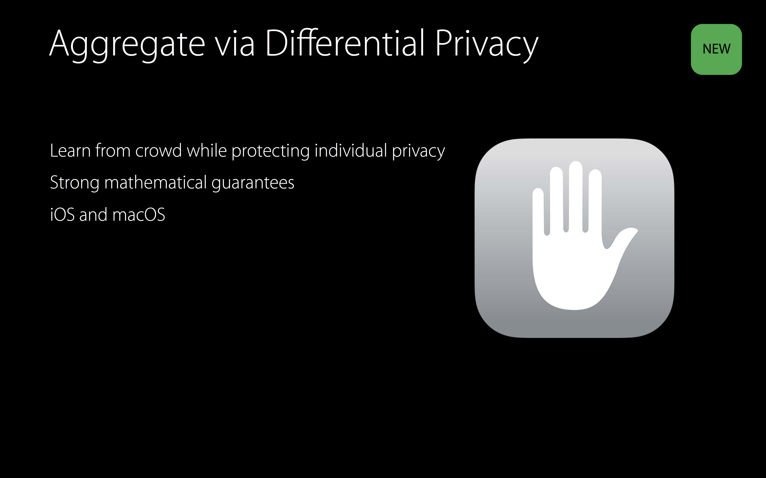
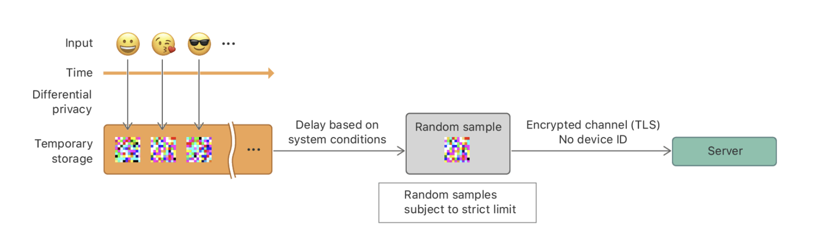
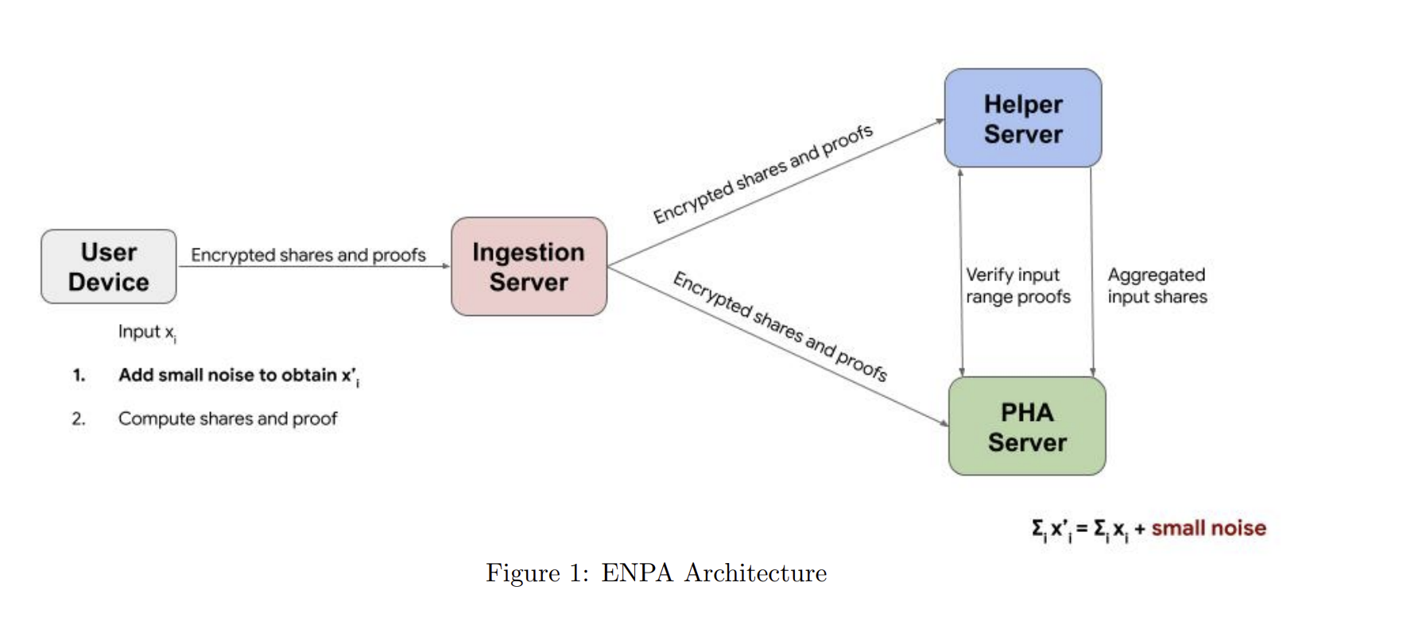
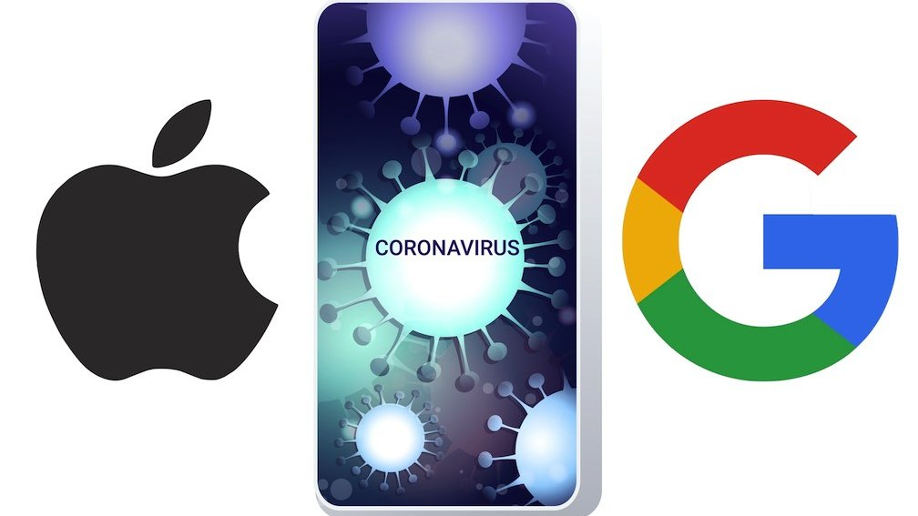
DP applications in community sensing
Local DP (variant of distributed DP) is used by Apple
2. Distributed DP is used by Apple and Google
It is limited to smartphone-based applications
Notes:
Tech giants: Apple, Google have already implemented this Differential privacy in community sensing. But user device is mostly the smart phone.
***********************************************
ENPA : Exposure Notification Privacy-preserving Analytics

Slide 7
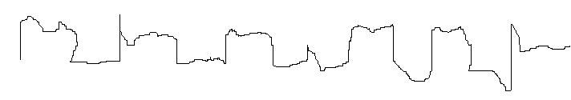
How Differential Privacy is enabled in wearables?
Wireless
Server
Sensor 1
I2C
Processor
Encryption
Sensor 2
I2C
.
.
.
.
.
Noise Generation & Perturbation
.
.
.
.
.
SPI
Wireless Communication Module
BLE/ WiFi
I2C
Sensor x
Wearable
Notes:
Since noise is key in differential privacy, basically we generate noise at the processor in wearable and perturb clean data generated by the sensor.
This noise generation and perturbation must be done repetitively for data produced by sensor.

Slide 8
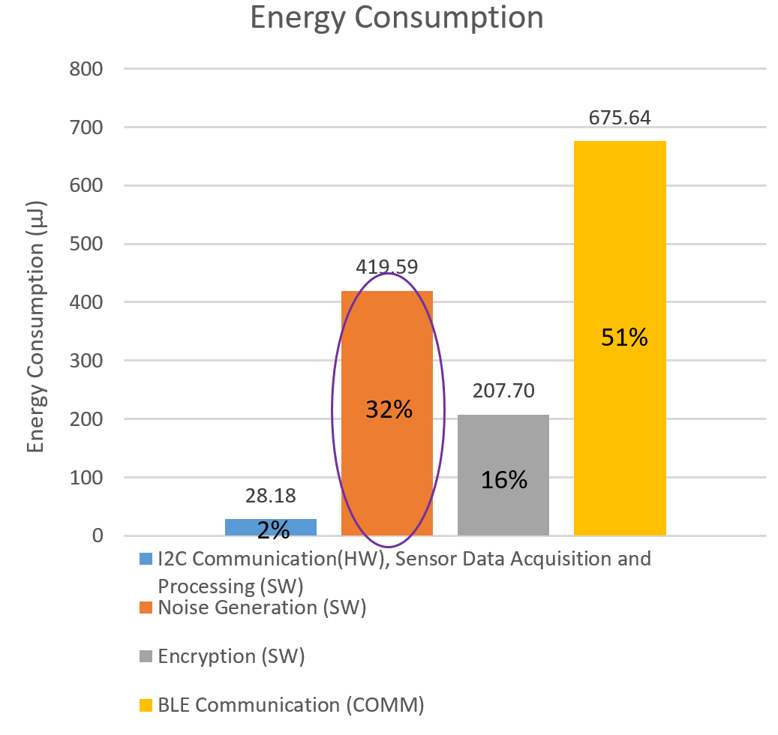
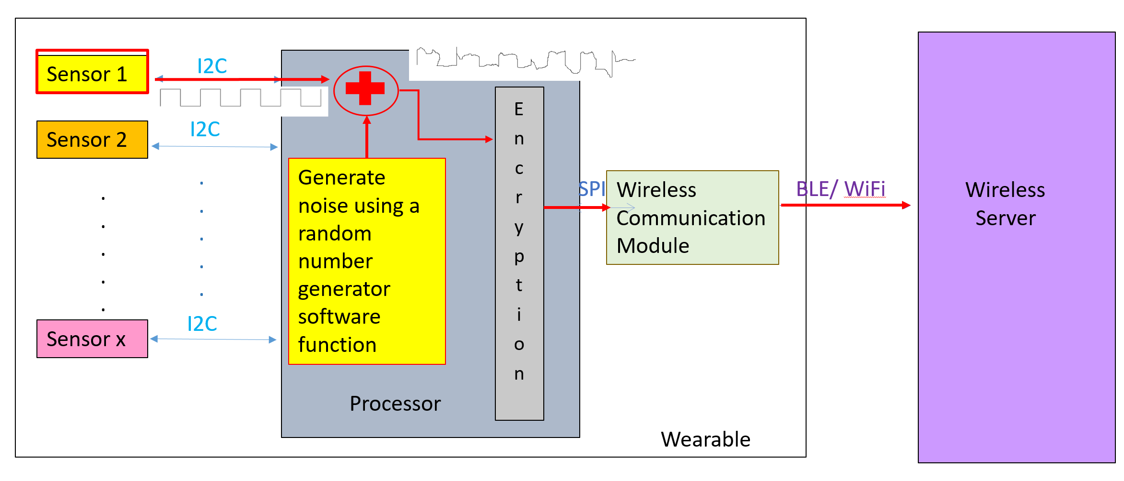
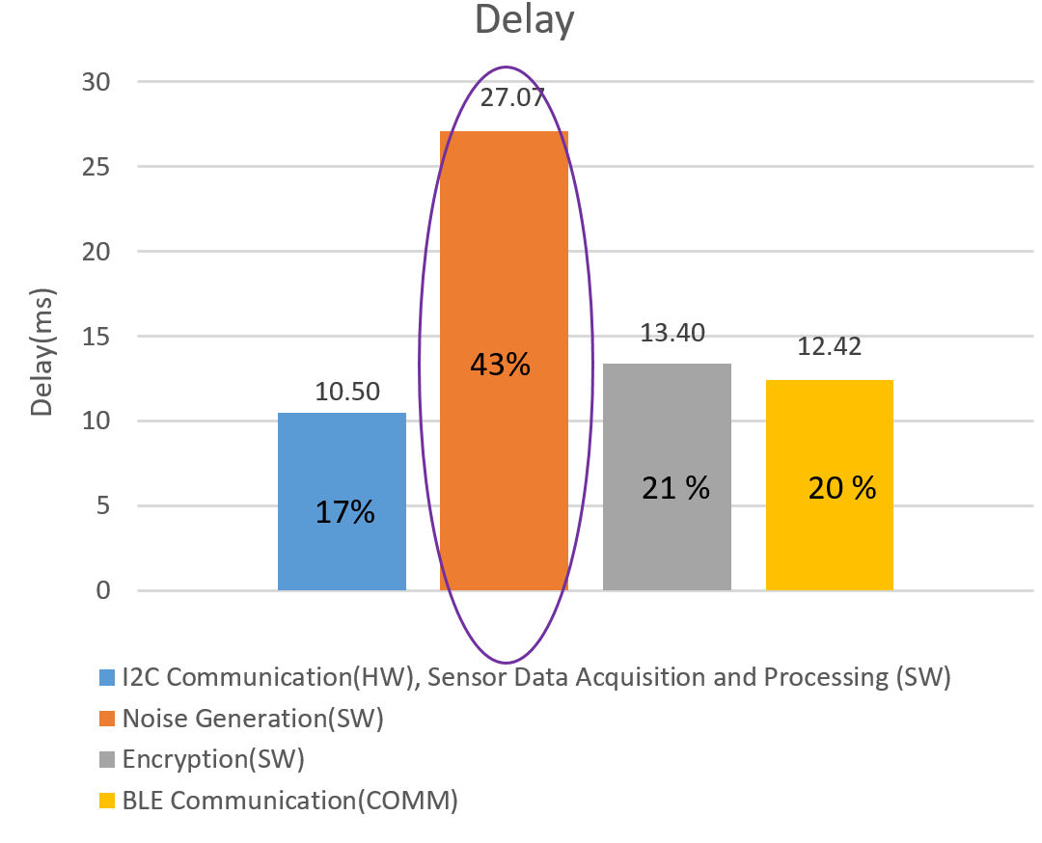
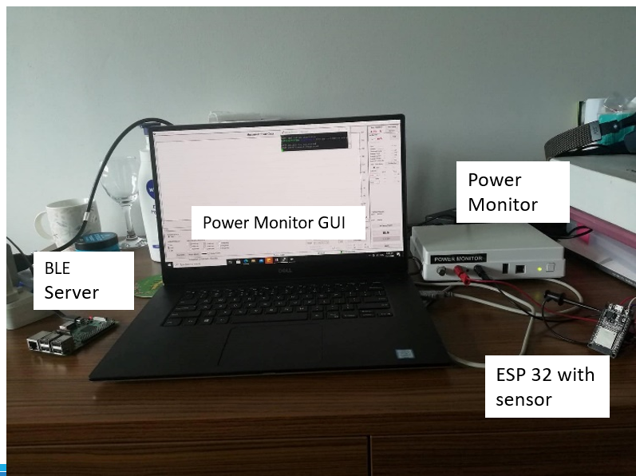
Is noise generation favorable for wearable?
Software noise generation
Adds 43% delay
Consumes 32% energy
Time and energy loss is continuous
MPU-9250 accelerometer :125Hz Sensor Sampling Rate, 20Hz LPF, 2g range , I2C Clock frequency: 800kHz, Connection interval :6.25- 7.5 ms , MTU : 345, Monsoon Power Monitor
For 340bytes (680ms data)
SD of white Gaussian Noise : 0.1
Notes:
To study the favorability of noise generation for wearable, we implemented simple wearable based community sensing setup. ESP32 development board along with accelerometer sensor used to act as wearable and implemented BLE server using Raspberry Pi development board. Then measured delay and energy consumption.
We observed that software noise generation adds 43% delay and consumes 32% energy.
As mentioned earlier, this noise generation and perturbation must be done repetitively for every data received from sensor. Hence time and energy loss is also continuous.

Slide 9
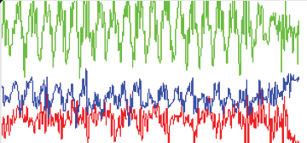
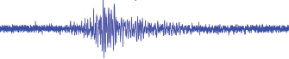
Can we get rid of software noise generation in DP for wearables ?
Raw sensor data is very noisy…
Let's consider accelerometer sensor,
Acc X
Acc Y
Inherent random noise present in the accelerometer Sensor data
Acc Z
Raw accelerometer sensor data
But it should follow statistical distribution: Gaussian to give a statistical guarantee.
Allan Deviation analysis can be used to quantify SD of white Gaussian noise available
Notes:
03.40
Though sensor data comes with noise, noise must follow statistical distribution like Gaussian to provide a statistical guarantee. Allan Deviation analysis can be used to identify the availability of Gaussian noise in sensor data.
*********************************************************************************************
After knowing the amount of white Gaussian noise available in the sensor, let’s have look on differential privacy noise requirement in community sensing.

Slide 10
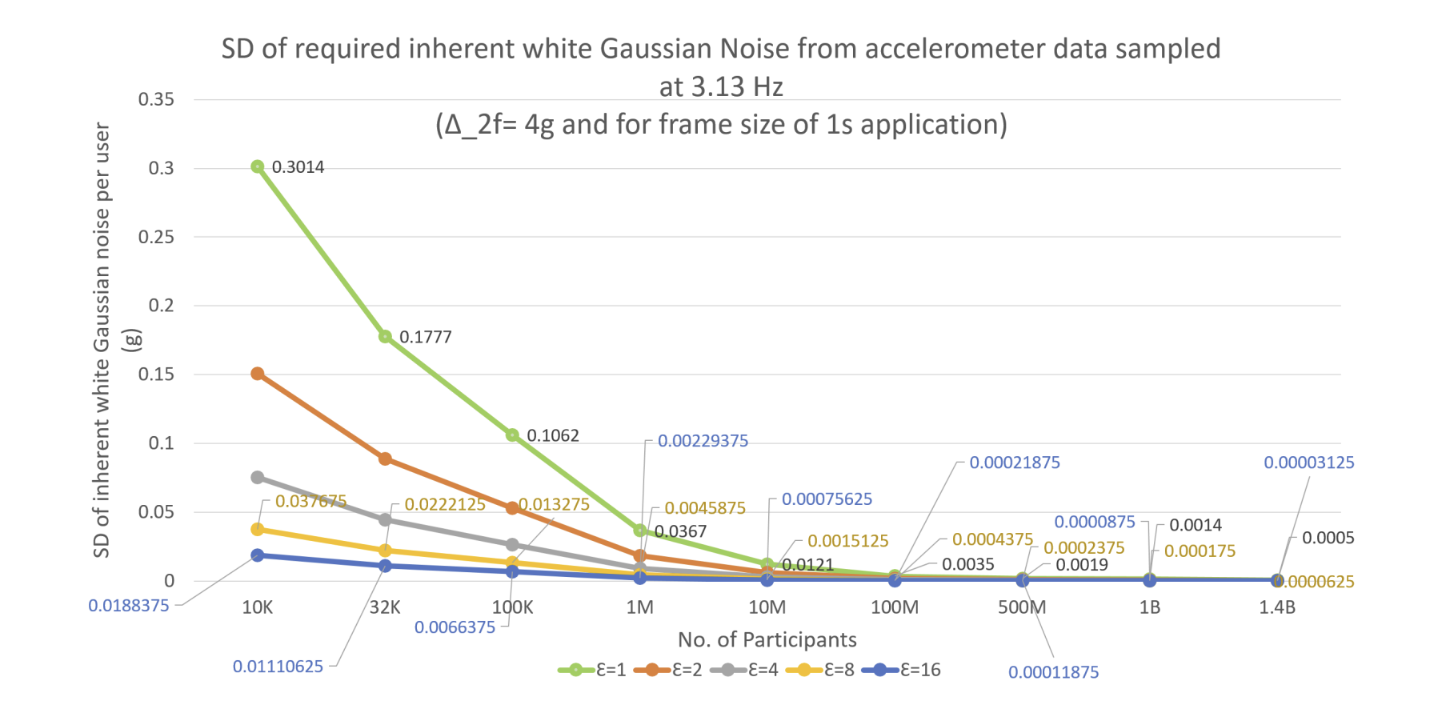
Differential Privacy noise requirement in community sensing
Differential privacy noise requirements vary, wearable must produce different amounts of Gaussian noise !!
Notes:
Since no. of participants taking part in community sensing program and privacy guarantee provided by organizers affects differential privacy noise requirement,
Let’s analytically simulate DP noise requirement in community sensing
Higher community participation lower the privacy noise required.
Lower community participation higher the privacy noise required.
Have privacy guarantee lower provides more privacy. Hence more privacy noise
Hence wearable must be able to produce different amounts of Gaussian noise to facilitate DP for different community sensing settings.
/**********************************************************************************/
We need to perturb data with a lesser amount of noise for higher community participation. Further for higher privacy, it is needed to perturb with the higher amount of privacy noise. Please note here epsilon is the privacy guarantee. The lower the epsilon higher the privacy.

Slide 11
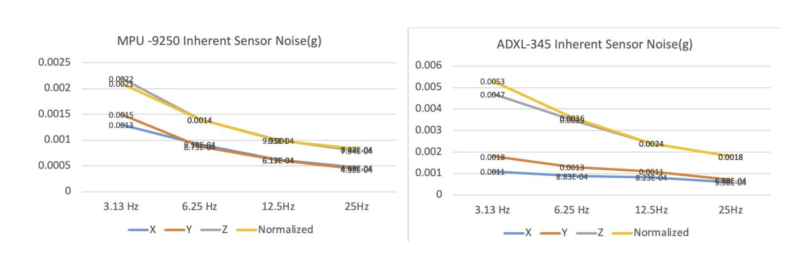
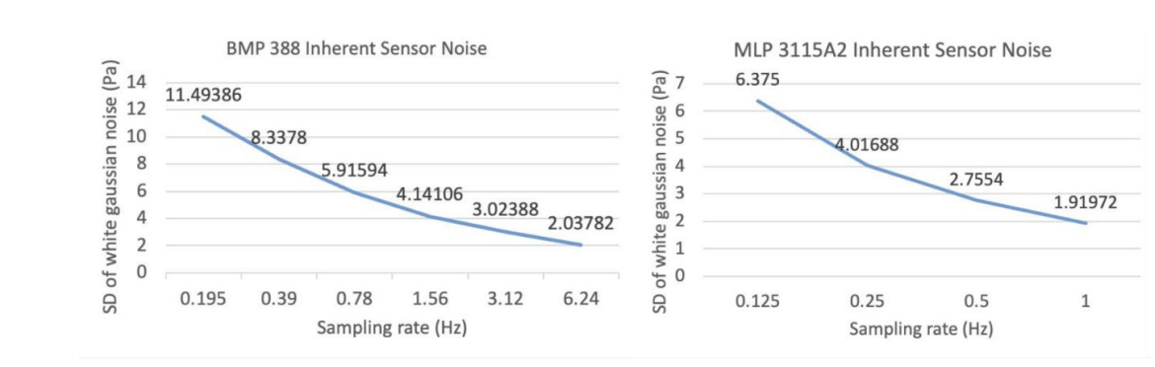
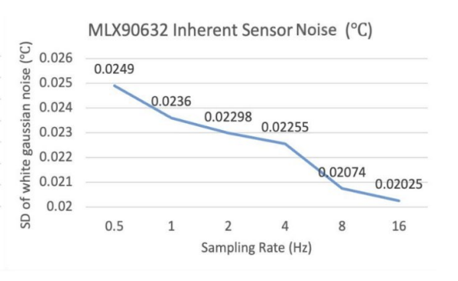
Sensor's ability to produce different amounts of noise
Accelerometer
Wearable sensors have the ability to produce different amount of gaussian noise by changing sampling rate.
Barometer
Body Temperature Sensor
Notes:
Then let's explore sensor's ability to produce different amounts of noise. For this we considered three wearable sensors: accelerometer, barometer and body temperature sensor. When we lower the sampling rate the higher amount of noise is produced and vice versa. So sensors are able to produce different amounts of noise by changing sensor configuration, the sampling rate. With these observations, let's move to our approach.
************************************************************************************
Then we varied sampling rates and collected data traces. Allan Deviation analysis was applied to quantify the SD of gaussian noise available. SD of gaussian noise produced at different sampling rates are shown here.

Slide 12
Our Approach: Inherent hardware sensor noise-based Differential Privacy
Filtering
Range
Sampling Rate
Wireless
Server
I2C
Processor
Sensor 1
Encryption
Sensor 2
I2C
.
.
.
.
.
SPI
Wireless Communication Module
BLE/ WiFi
.
.
.
.
.
I2C
Sensor x
Wearable
Notes:
4min
So, In Serandip, we configure these sensor settings to produce sensor data with noise required for differential privacy.

Slide 13
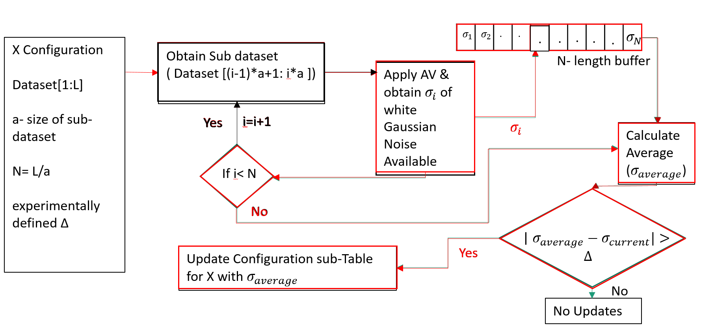
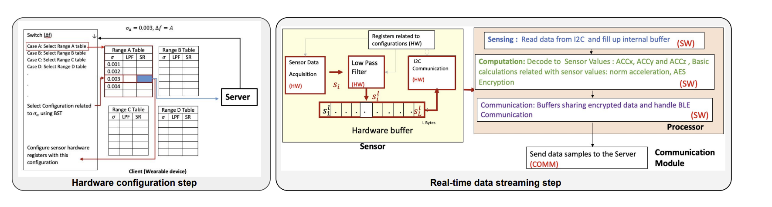
System Design
Three Steps:
Hardware configuration
Real-time data streaming
Inherent sensor noise update
Inherent sensor noise update
Notes:
Our system mainly has three steps: Hardware configuration, real-time data streaming and inherent sensor noise update

Slide 14
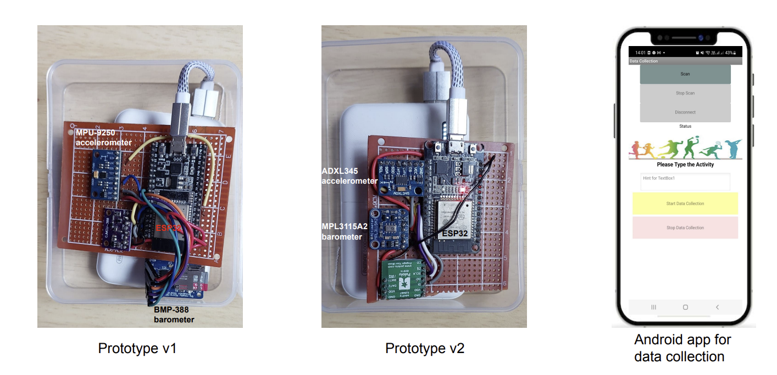
Evaluations- User study
Configured Sampling Rates:
3.13 Hz for accelerometers
0.78 Hz for BMP 388
0.125 Hz for MPL3115A2
10 Participants (5 male, 5 female)
Activities (5 minutes each):
Standing
Sitting
Walking
Jogging
Stairs up and down
Elevator up and down
Escalator up and down
Notes:
For evaluations, we conducted a user study where asked 10 participants to wear one of our prototype and engage in activities: standing, sitting, walking, jogging, stairs up and down, elevator up and down escalator up and down for 5 minutes each. We built up a dataset from the data collected from user trial.

Slide 15
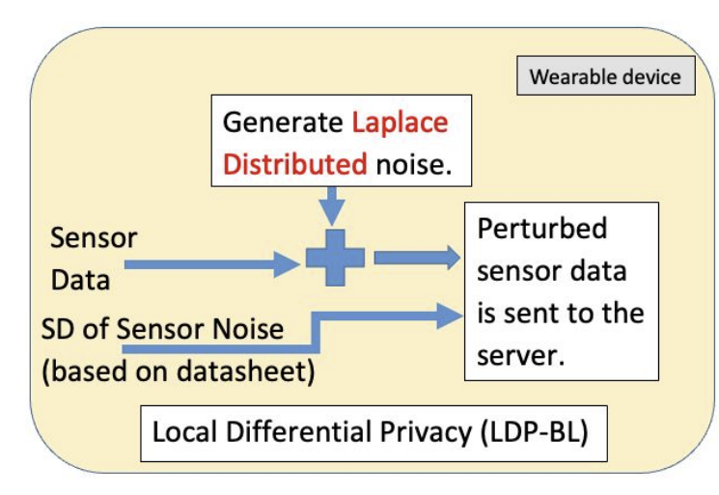
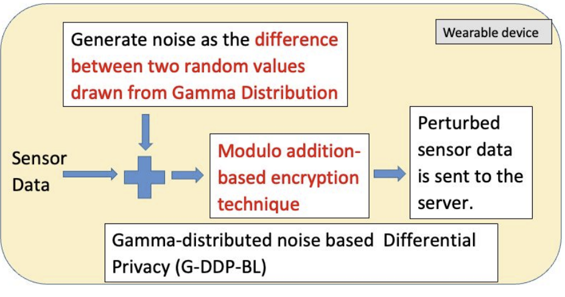
Evaluation - Baselines
DDP-BL
Notes:
Three baselines were used to compare our system. Noise generation and perturbation is common in all three baselines.
*****************************if asked****************
Statistical distribution used for noise generation is different in baselines

Slide 16
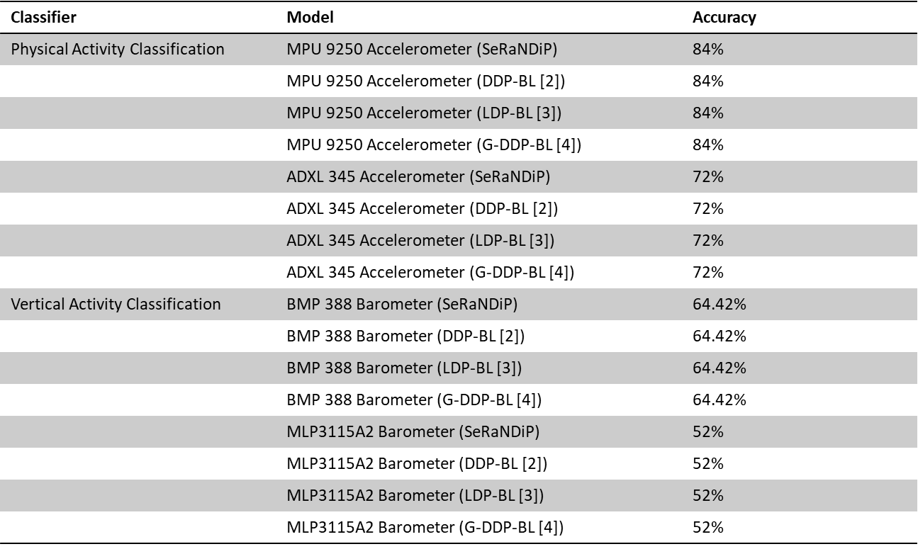
Evaluations- User level accuracy results
Notes:
For user level accuracy evaluations, we implemented physical activity classifier for accelerometer data and vertical activity classifier for barometer data. Since noise generation happens at the processor, still user level classification can be done on original sensor produced data.

Slide 17
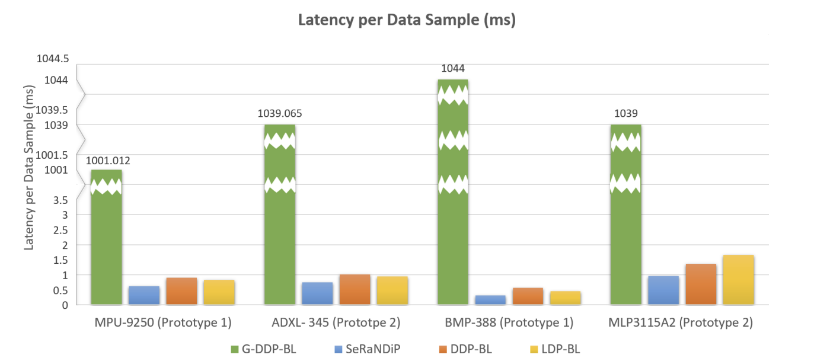
Evaluation –Latency results
SeRaNDiP w.r.t accelerometer
1.4 X, -1596X times faster than baselines
SeRaNDiP w.r.t. barometer
1.4X-3334X times faster than baselines
SeRaNDiP is the fastest !!!
Notes:
We evaluated Serandip's latency compared to the baselines.
The latency per sensor data sample achieved by SeRaNDiP is consistently lower when compared to baselines.
***********************************************************************************
Since encryption is not required in LDP-BL, LDP-BL results in the lowest latency compared to other baselines.
However, the latency from noise generation is much higher compared to encryption (see Figure 4) and thus, SeRaNDiP still achieves the fastest latency.

Slide 18
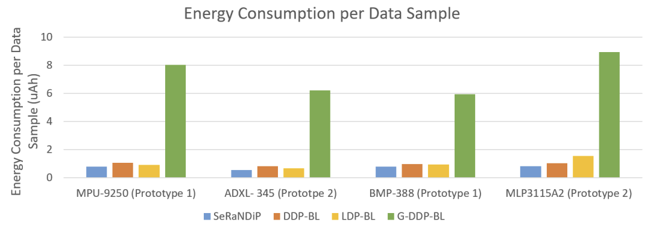
Evaluation- Energy results
SeRaNDiP w.r.t. accelerometer
1.4X-11.2X lower compared to baselines
SeRaNDiP w.r.t. barometer
1.2X -10.7X lower compared to baselines
SeRaNDiP has the lowest energy consumption !!!
Notes:
Based on our evaluation w.r.t. energy consumption, Serandip resulted the lowest energy consumption.
SeRaNDiP’s low energy consumption can be attributed to the elimination of the compute-intensive random noise generation procedure

Slide 19
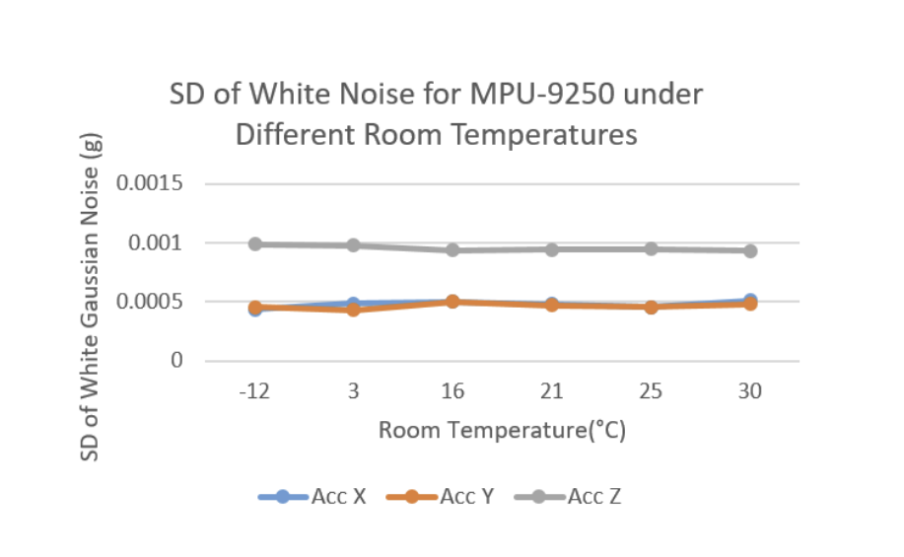
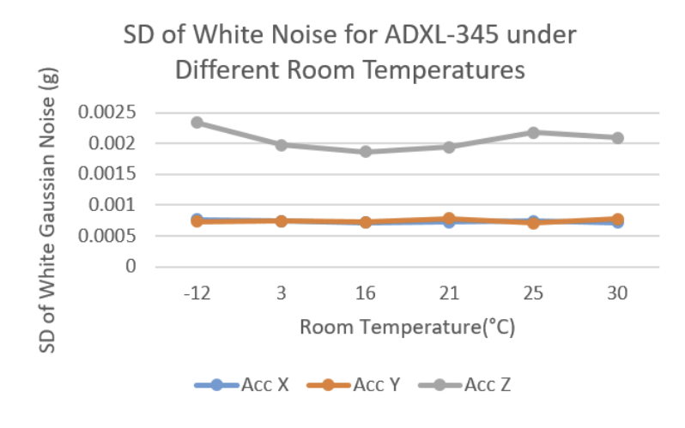
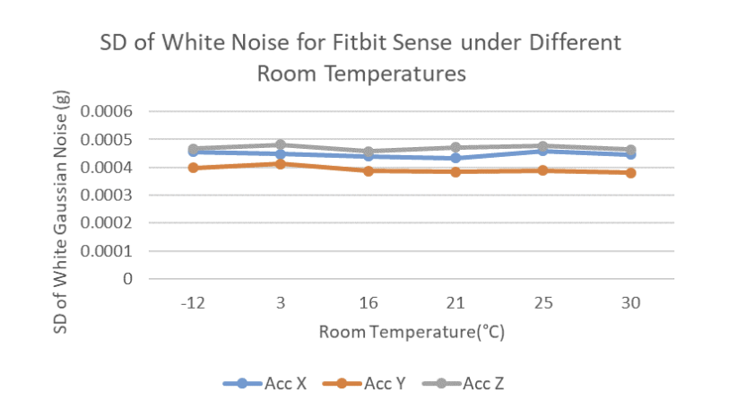
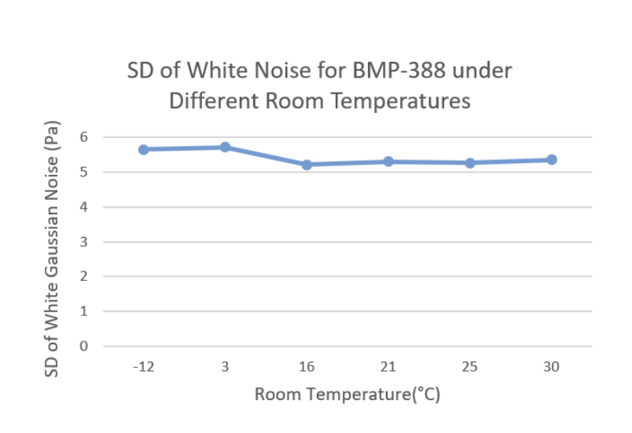
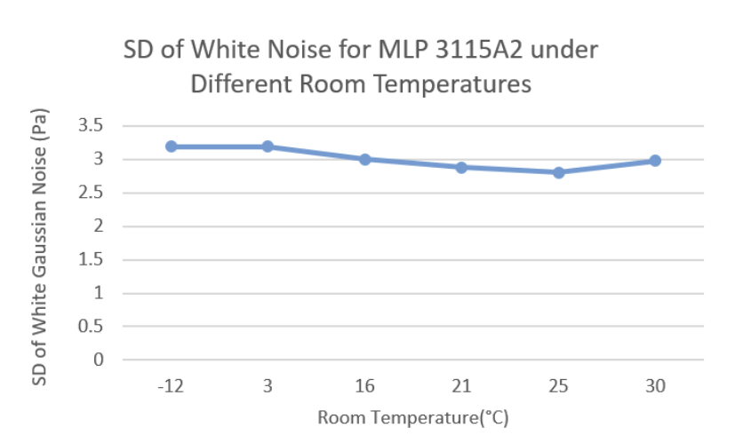
Evaluation – Robustness to environment temperature variation
Validates SeRaNDiP’s robustness to environmental temperature variations
Notes:
Since people live under different weather conditions, wearable devices also operate in varied environmental temperatures. Hence we evaluated the robustness to environtment temperature variation.
the SD of the gaussian noise produced by both the accelerometers do not change significantly with respect to temperature variations. Similarly, we see that both the barometers’ gaussian noise only change negligibly with respect to temperature variations.
the same trend is also observed in the sensor data collected from the FitBit Sense smartwatch. The results validate the robustness of SeRaNDiP to temperature variations in the environment.
******************************************************************************************************************************************************
The thermal noise in sensors is white gaussian and arises from the vibration of charge carriers within the sensor. The thermal noise’s power density is directly proportional to the temperature [1] and thus, the standard deviation of thermal noise is proportional to √ 𝑡𝑒𝑚𝑝𝑒𝑟𝑎𝑡𝑢𝑟𝑒𝐾𝑒𝑙𝑣𝑖n.
Depending on the environmental conditions, the SD of the noise produced in sensors would be 0.072X lower at -12𝑜𝐶 compared to 30𝑜𝐶. Thus, variations in environmental temperature have only a negligible impact on the total noise generated by the sensors. In SeRANDiP, we can also build configuration tables taking into account the SD of the inherent sensor noise under the lowest environment temperature in which humans can survive (when the amount of thermal noise generated is the lowest). By doing so, SeRaNDiP can provide privacy guarantees for higher temperatures.
Experimental Setup: We left our prototypes and the Fitbit Sense stationary on a flat table in an airconditioned room with adjustable temperatures(between 16𝑜𝐶 to 30𝑜𝐶) and collected data from each sensor for 2 minutes under four different temperatures: 16𝑜𝐶, 21𝑜𝐶, 25𝑜𝐶 and 30𝑜𝐶. After configuring the air conditioner to a given temperature, we waited 15 minutes for the room to be cooled to the set temperature value. To study the effect of much lower temperatures on the sensor noise, a refrigerator was used. Since the motor in the refrigerator induces motion signals in the accelerometer sensor, the refrigerator was switched on for 30 minutes and switched off during the 2 minutes of data logging. With the refrigerator, we collected sensor readings under two different temperatures of 3𝑜𝐶 in the normal compartment and -12𝑜𝐶 in the freezer compartment. Before each measurement, the temperature was verified using a Xiaomi Mi Temperature and Humidity monitor.

Slide 20
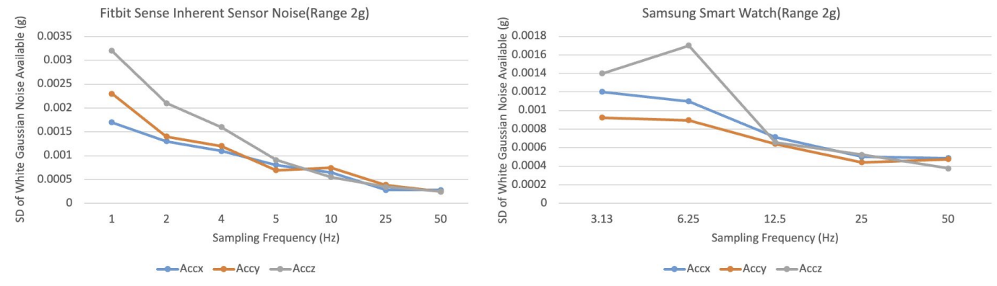
Evaluation-Applicability to commercial smartwatches
SeRaNDiP can be readily applicable to commercial smartwatches!!!
Notes:
Time : 13 min
We expanded our evaluations to commercial smartwatches : Fitbit Sense and Samsung Galaxy. We could observe same trend : lower sampling rate higher noise for smart watch sensors.
Hence Serandip can be readily applicable to commercial smart watches.

Slide 21
Limitations
Our current work is limited to raw sensor data
SeRaNDip requires a minimum no. of participation
Impossible to simulate a real-world framework due to the unavailability of larger in-field raw sensor data sets
Wearable sensor settings must be configurable for the Serandip application.
Notes:
As every work, our work also has few limitations. Currently our work is limited to raw sensor data. Secondly , since we are using off-the-self sensors, there is a maximum amount of noise that can be generated by sensor. Hence Serandip has limitation in minimum number of participants : <<Have numbers here, in case>> . Since participation to community sensing happens in thousands and hundred thousands, it is required to have large raw data sets for real-world simulations. Finally since serandip needs to change sensor configuration before starting of the session, wearable's sensor settings must be able to control by API , not hardcoded.

Slide 22
Future works
Expand our system
to send data features:
steps, heart rate from wearable to server with DP without noise generation
to other wearable and environmental sensors:
PPG, ambient light, GPS, microphone
Explore the possibility of providing DP to weight sharing in federated learning by using sensors
Simulate a complete framework with a large number of participation
Notes:
As future works, we are planning to expand our system to data features like steps ,heart rate instead of raw data
And also expand our system to other wearable and environmental sensors: PPG, ambient light, GPS, microphone
Explore the possibility of providing DP to weight sharing in federated learning with using sensors
Simulate complete framework with the help of data from large number of participation.

Slide 23
Summary of SeRaNDiP
Framework which considers inherent sensor random noise for differential privacy preservation in wearable community sensing applications
Leverages sensors’ inherent noise by changing sensor configurations at the software level without any hardware modifications
Can provide differential privacy to a variety of wearable sensors in different wearable platforms under different temperature conditions while delivering energy and latency savings
Can be readily applied to today’s wearables, smartwatches and smartphones
Notes:
To Sum up,
We proposed a framework which considers inherent sensor random noise for differential privacy preservation in wearable community sensing applications
Our work leverages sensors’ inherent noise by changing sensor configurations at the software level without any hardware modifications
It can provide differential privacy to a variety of wearable sensors in different wearable platforms under different temperature conditions while delivering energy and latency savings
Serandip can also be readily applied to today’s wearables, smartwatches and smartphones

Slide 24
References
[1] A. Cheu, “Differential privacy in the shue model: A survey of separations," 2021.A. C. L. Foschini, J. Goldsack and Y.X.Wang, Contributed: When tness data becomes research data, your privacy may be at risk," February 2021. [Online]. Available: https://www.mobihealthnews.com/news/contributed-when-tness-data-becomes-researchdata- your-privacy-may-be-risk
[2] Cynthia Dwork and Aaron Roth. 2014. The Algorithmic Foundations of Differential Privacy. Foundations and Trends® in Theoretical Computer Science 9, 3–4 (2014), 211–407. https://doi.org/10.1561/0400000042
[3] Yuichi Sei and Akihiko Ohsuga. 2020. Differentially Private Mobile Crowd Sensing Considering Sensing Errors. Sensors 20, 10 (2020). https://doi.org/10.3390/s20102785
[4] Gergely Ács and Claude Castelluccia. 2011. I Have a DREAM! (DiffeRentially privatE smArt Metering). In Information Hiding, Tomáš Filler, Tomáš Pevný, Scott Craver, and Andrew Ker (Eds.). Springer Berlin Heidelberg, Berlin, Heidelberg, 118–132. https://link.springer. com/chapter/10.1007/978-3-642-24178-9_9

Slide 25


THANK YOU
SeRaNDiP Paper :
SeRaNDiP Project Page:
ayangaim@comp.nus.edu.sg
Notes:
Thank you very much for listening. I am happy to take your questions.

Slide 26
Back-Up slides

Slide 27


Wearable sensors
Heart Rate PhotoPlethysmoGram(PPG)
Steps
Inertial Measurement Unit (IMU)
Taking Stairs ?
Barometer
Indoor /Outdoor Ambient Light Sensor
Body Temperature
Temperature Sensor
Sound Intensity
Microphone
Location
GPS
Notes:
0.5min
These wearables comes with many sensors like PPG, IMU, Barometer, Ambient Light Sensor, Temperature Sensor, GPS and microphone
They used to measure heart rate, Steps, vertical motion, indoor/outdoor locality, body temperature, location, sound intensity and many more

Slide 28
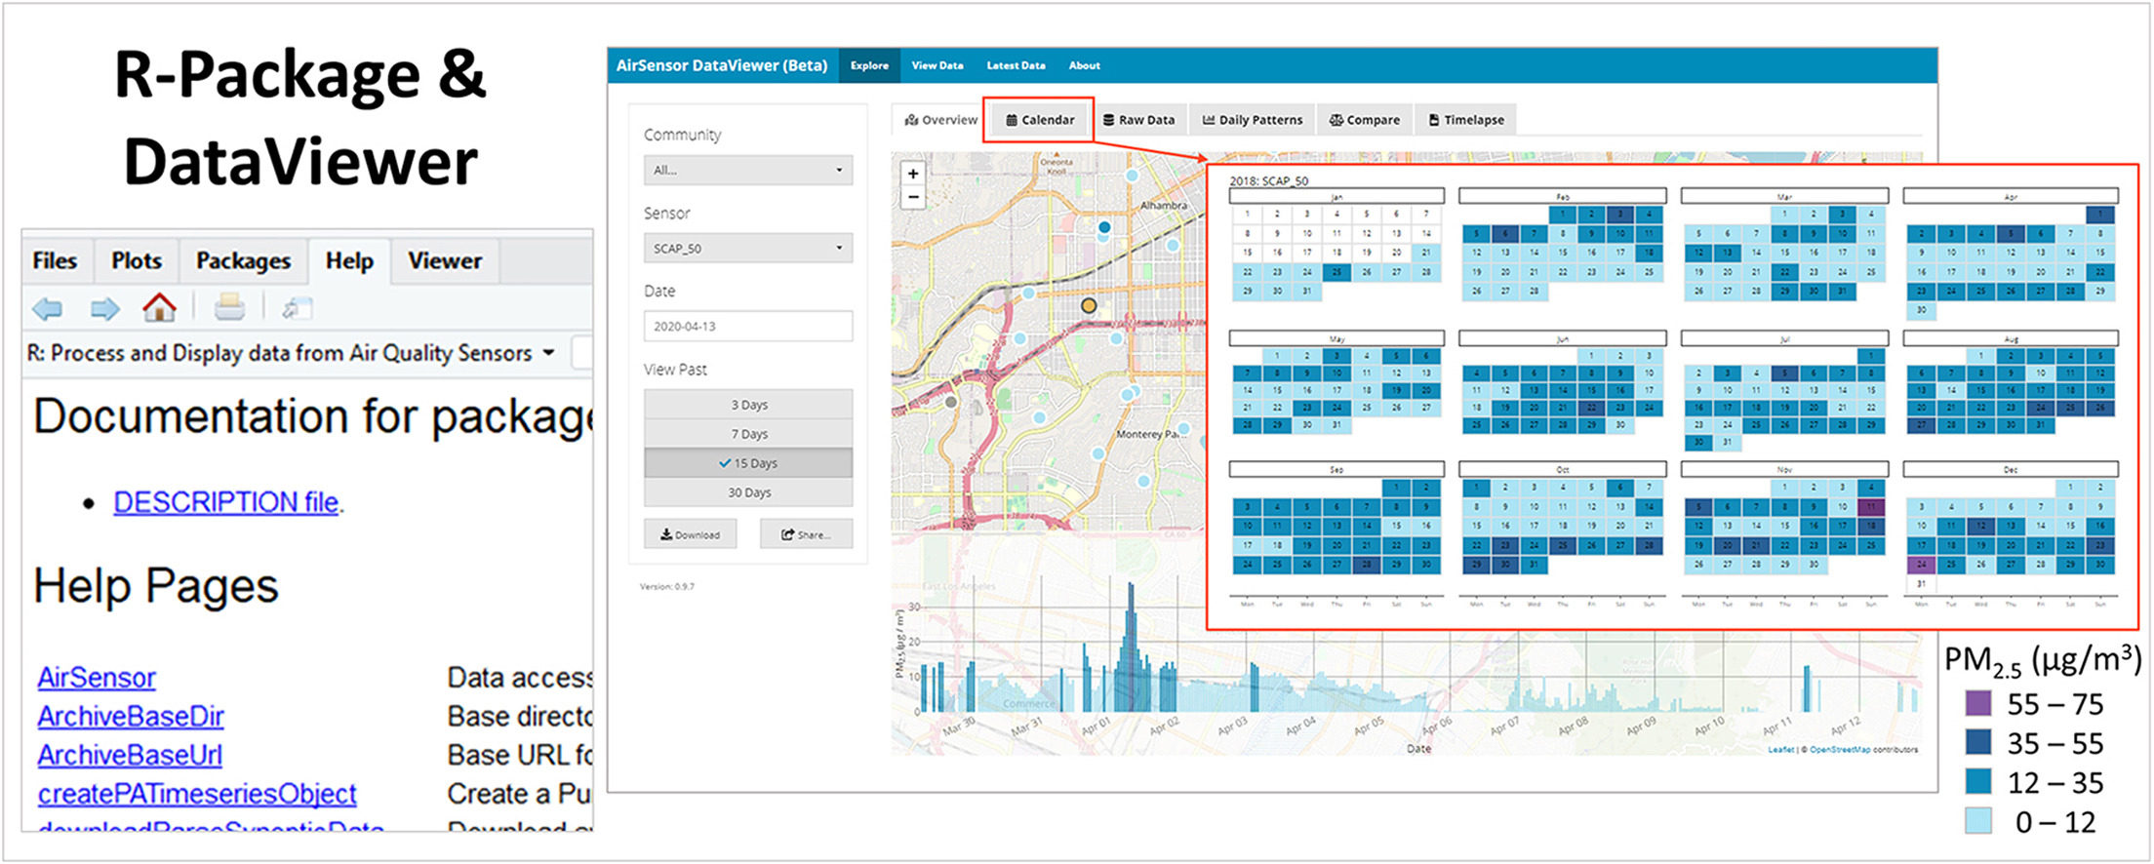


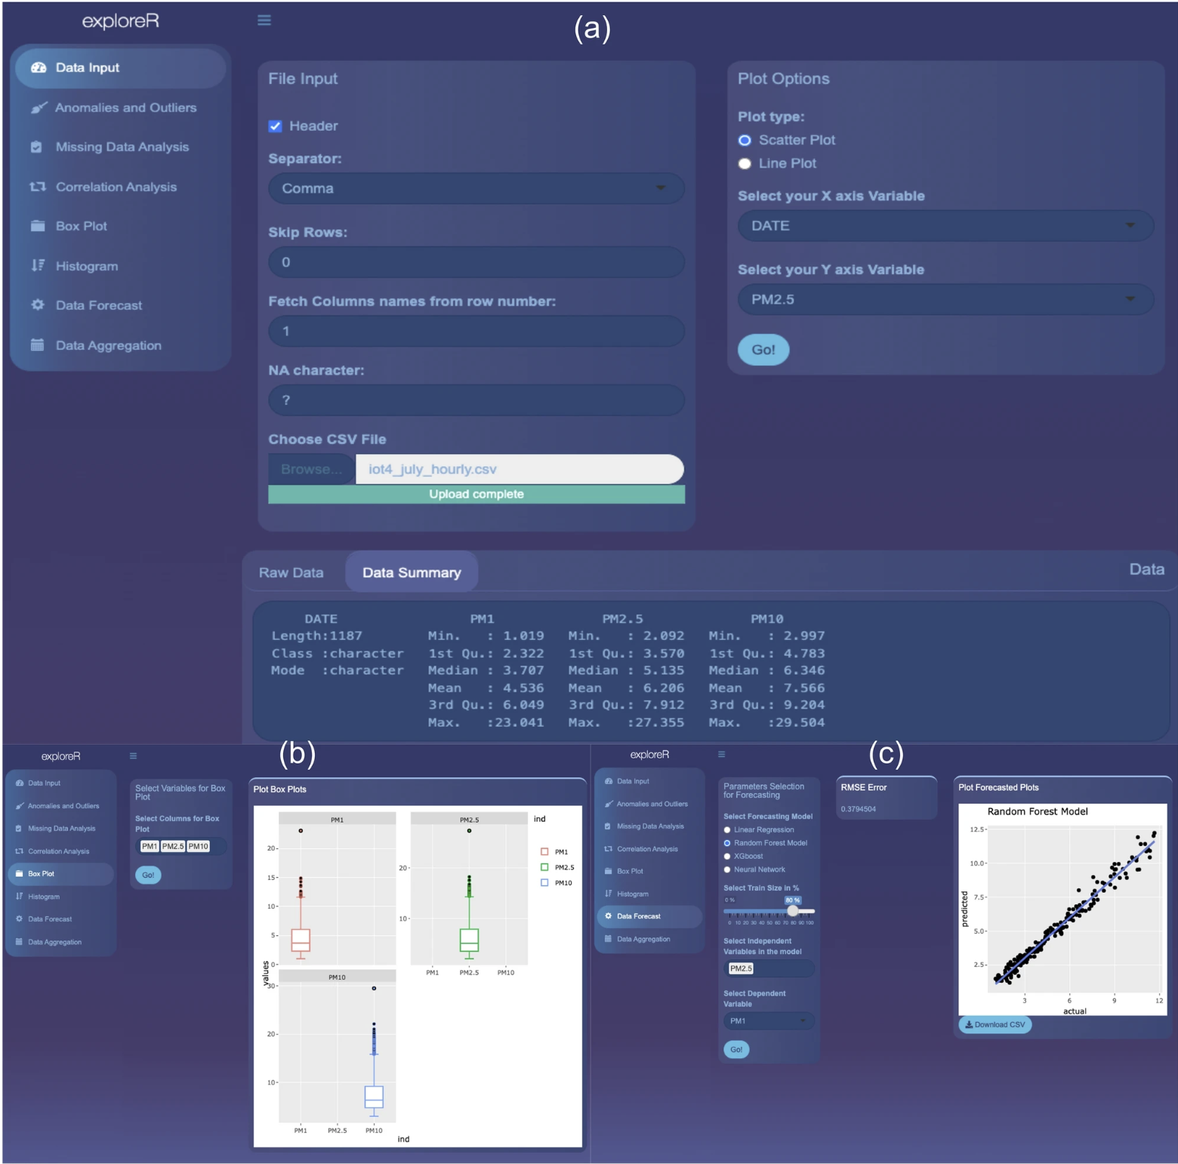
Open-source AI raw data analytics tools
AirSensor
ExploreR

Slide 29
Benefits of Collecting Raw Data
Raw data can be used to accurately characterize sensors
Raw data enables analysis by validated algorithms
Algorithms based on raw data are device independent
Raw data enables determination of measurement accuracy
Anomalies can be investigated using raw data
Study data can be re-analyzed with updated algorithms
Study data can be used for computations that a wearable cannot
Raw data enables combining data across multiple studies

Slide 30
Common concerns about collecting vast amounts of raw data
The data will be too voluminous to transmit, store, and manage
The amount of data involved is tiny compared to widespread consumer applications.
For example, a full month of 3-axis accelerometer data collected at 25Hz is well under 500MB.
In comparison, a typical standard-resolution digital movie file that is streamed daily to millions of homes is 1-2GB in size.
Web hosting services make this scale of data collection accessible and affordable for developers of wearable systems.
Nobody can actually look at that much data. Nobody needs to look at the data
It still gets processed by algorithms.
Humans see the same results, in the same form.
However, they also have access to additional algorithms, e.g., to look at the data in different ways and to assess the accuracy of the results.

Slide 31
Raw data based community sensing programs
Crowd-sourced raw IMU data from smartphones have been used to construct an open hazard data map for preventing bicycle accidents
helps transport authorities efficiently monitor road surfaces by detecting road potholes and bumps
Feverprint: a community sensing program from Apple that collects body temperature values from iPhone users to identify the normal range of temperatures for a country-wide population at different times throughout the day
Weather researchers use crowdsourced raw air temperature observations and raw atmospheric pressure measurements from smartphone barometer sensors to create a crowd-sourced intercontinental network for weather forecasting.

Slide 32
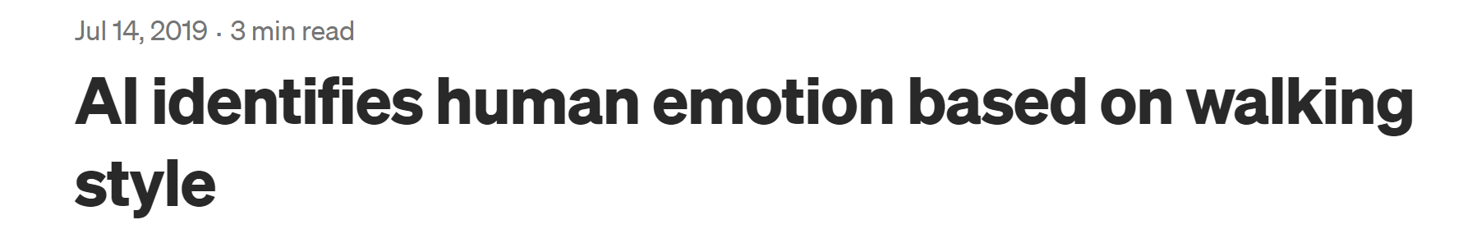
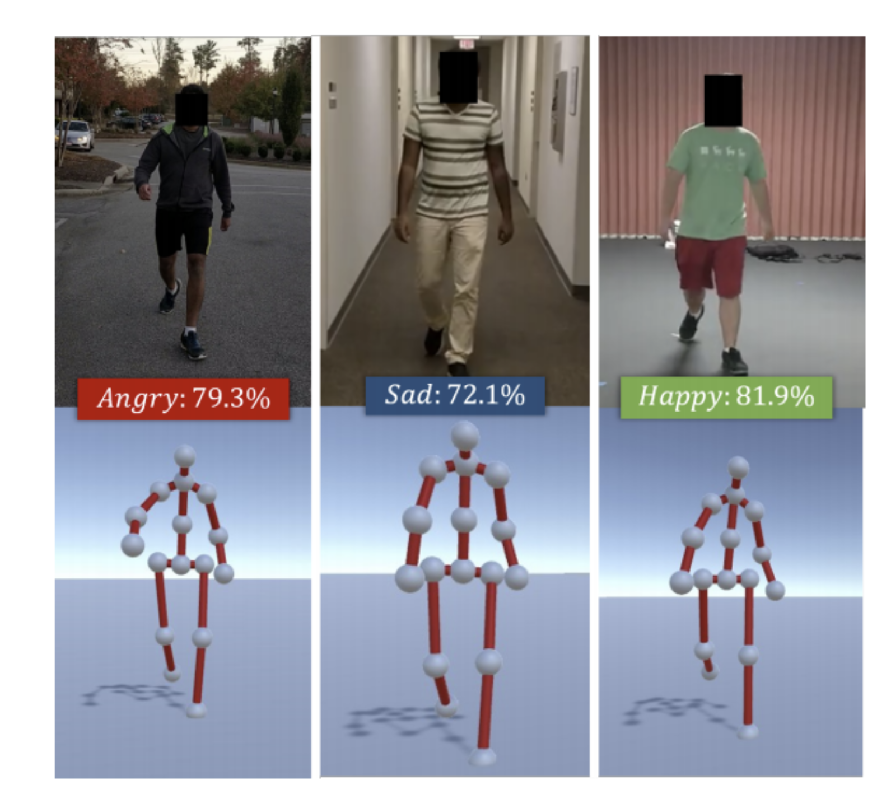




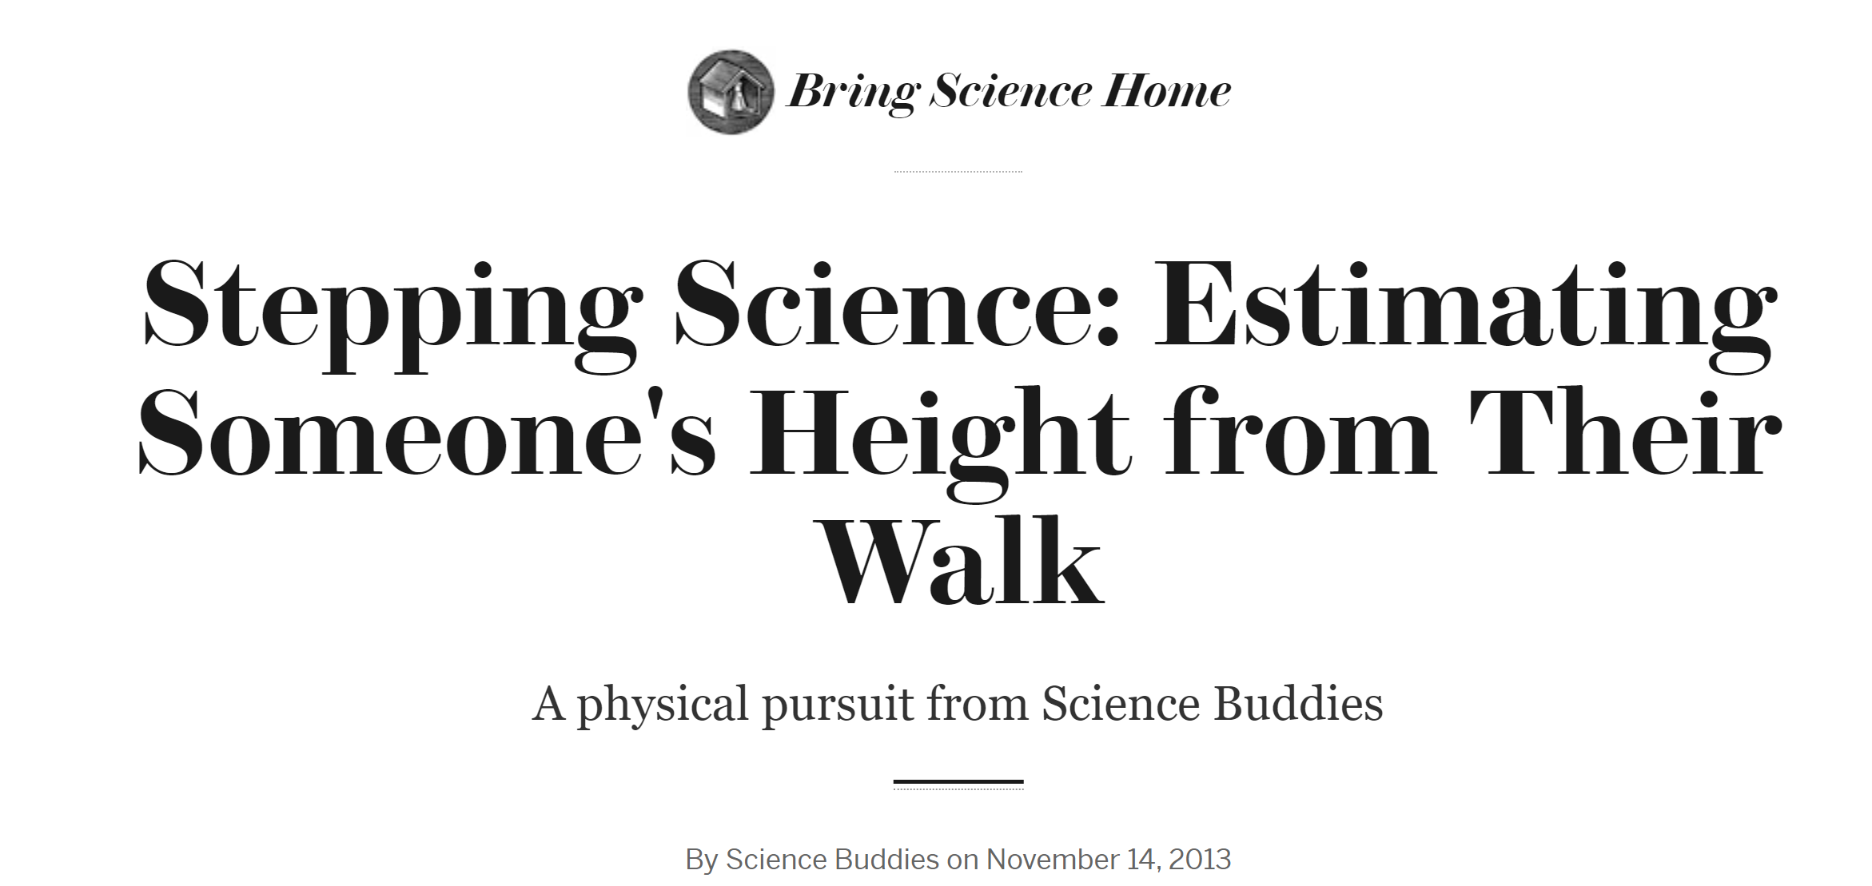
Accelerometer data sending challengers
Step counts of six days enable to identify a person from 100 million anonymized others [1]
…………………………………….
Day 1
Day 6
………………
100 million
Notes:
1.5min
Wearable data are interesting…
Let’s consider accelerometer sensor, .. It produces steps
If we monitor step count of a person for 6 consecutive days, we can identify him from 100 million people as shown in left
Walking style can also be used with ai to identify human emotion
Our height can also be estimated from the our steps.
So acc reveals more on us

Slide 33
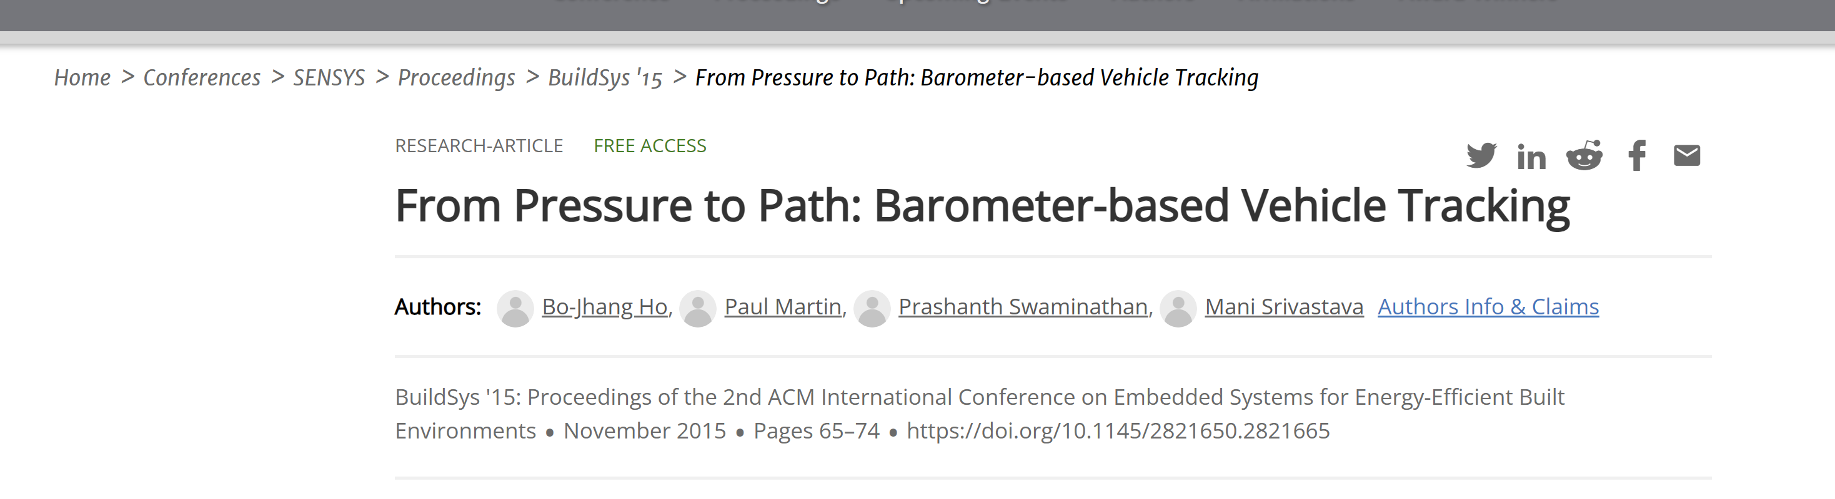
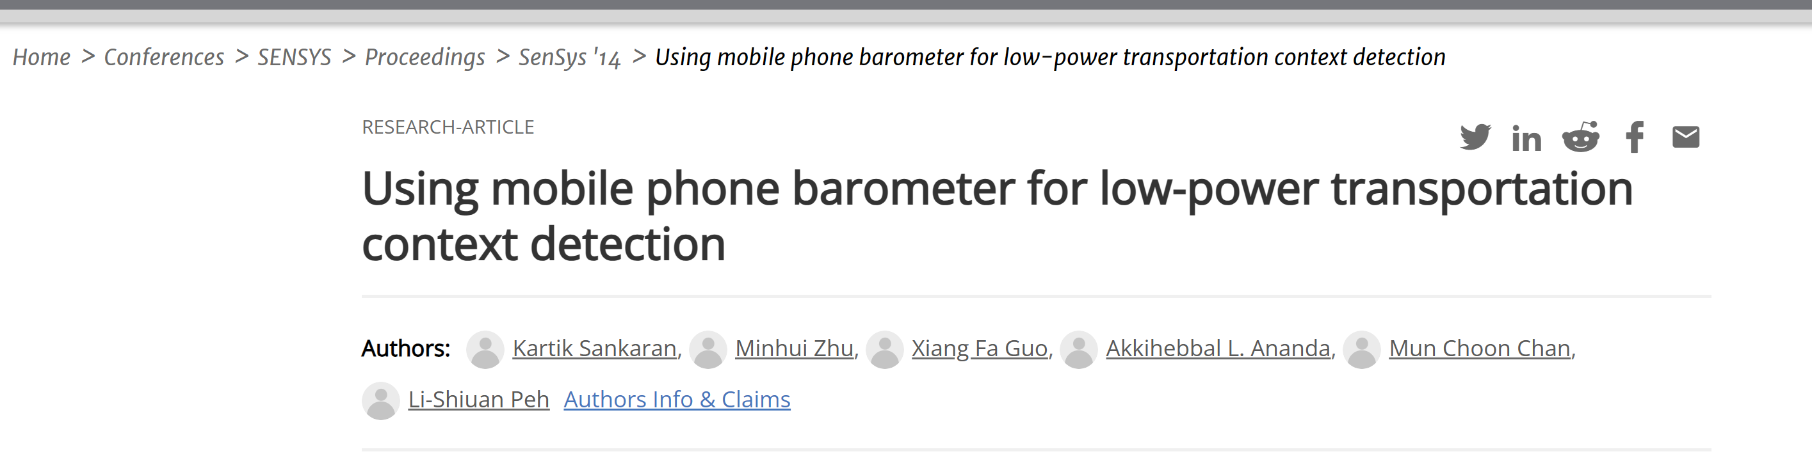
Barometer data sharing challengers

Slide 34


Temperature data sharing challengers

Slide 35
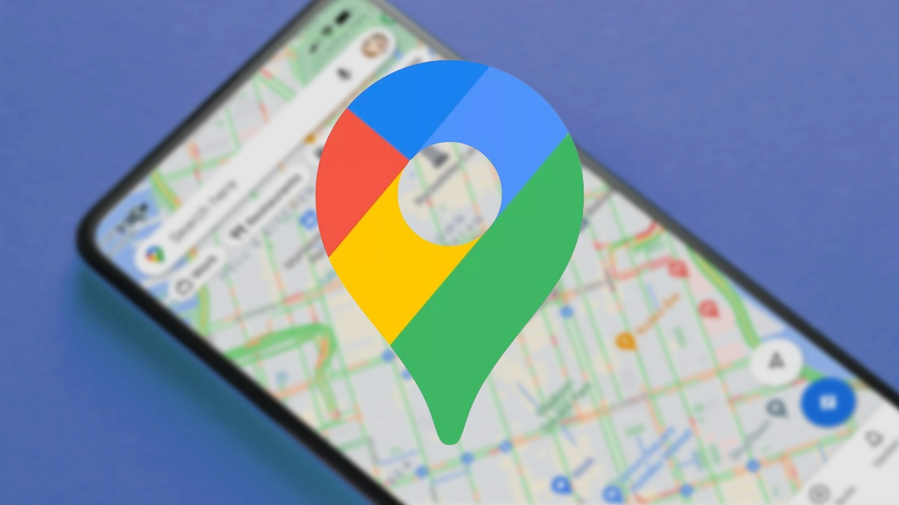
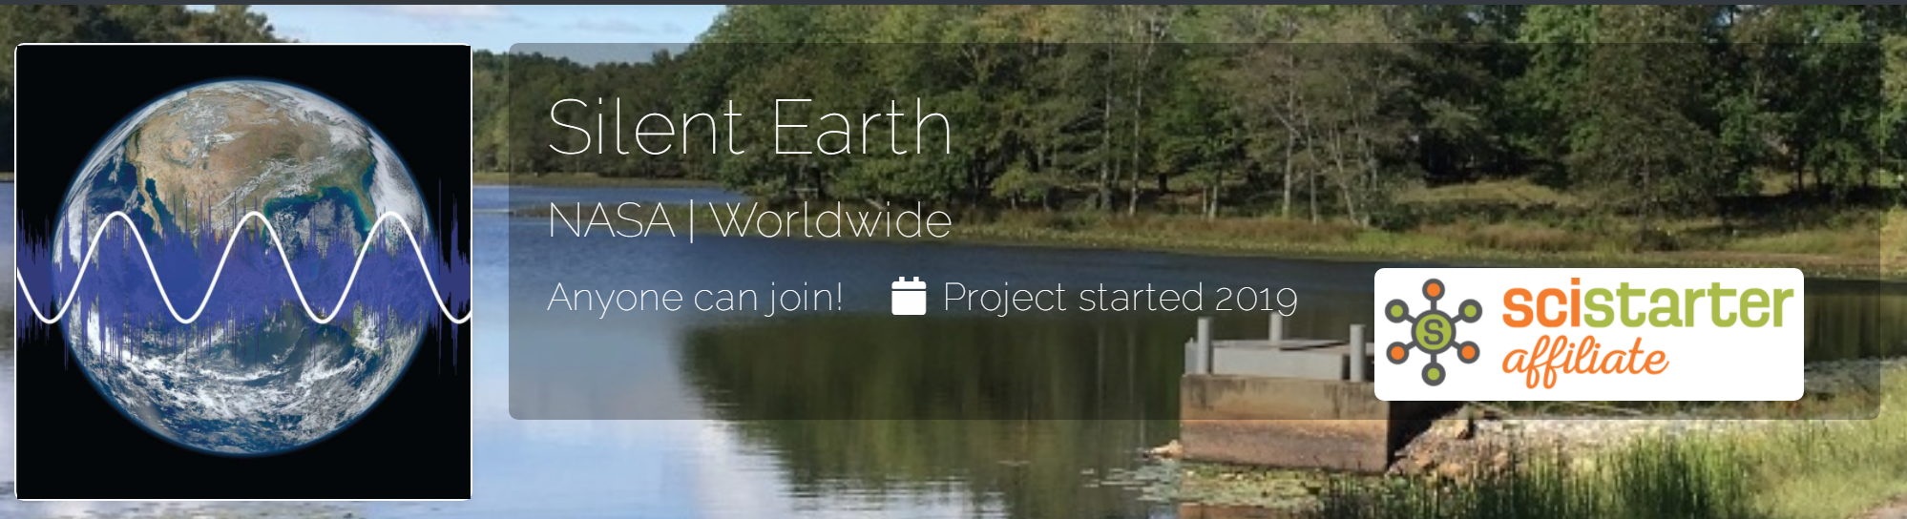


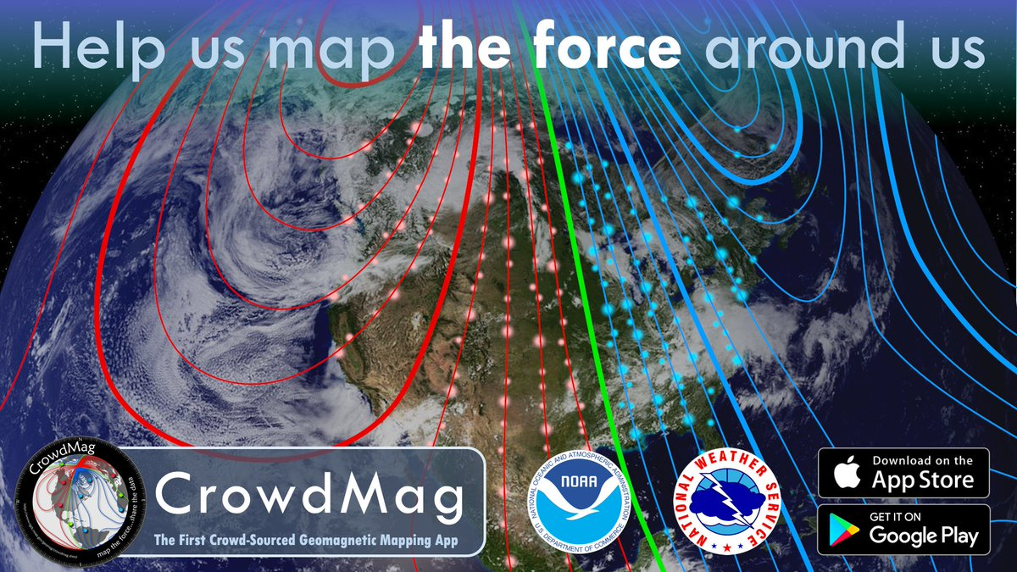
Sensor based community sensing applications
Microphone sound intensity, location
Heart Rate, Steps
location
Ambient Light Intensity, location
Magnetic field data, location
Acceleration, location
Notes:
This slide is included to show the wide applicability of community sensing

Slide 36
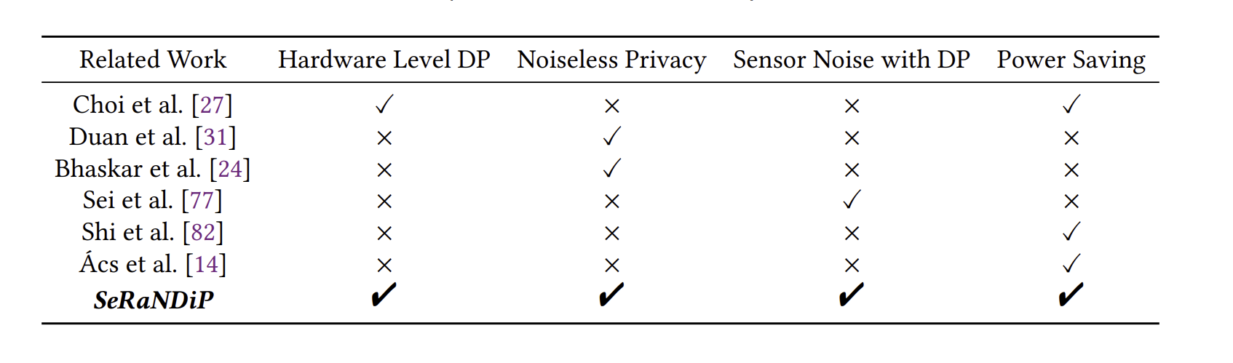
Related Works – Differential Privacy

Slide 37
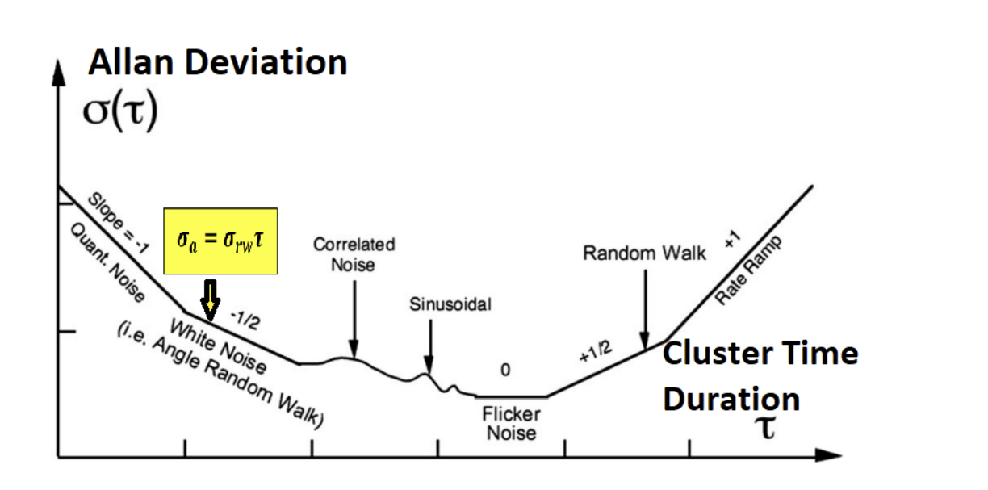
Allan Deviation for sensor noise analysis
Source : Juan Jurado, Christine M Schubert. Kabban, and John Raquet. 2019. A regression-based methodology to improve estimation of inertial sensor errors using Allan variance data. NAVIGATION 66, 1 (2019), 251–263. https://doi.org/10.1002/navi.278 arXiv:https://onlinelibrary.wiley.com/doi/pdf/10.1002/navi.278

Slide 38




Allan Variance
Random Noise Analysis method [31]
How to calculate Allan Variance for a signal [10]?
Divide the continuous time signal Ω(t) into non-overlapping clusters with duration 𝜏
averages over a duration 𝜏 → Ω̄k(𝜏)
computes the variance among groups as a function of varying 𝜏
Allan Deviation is square root of Allan Variance
As stochastistic noise components are independently prominent during different regions of τ,
Sub-Noise categories can be profiled and independently study
$$σ(1)$$
$$τ=1$$
If Allan Deviation curve slope is -0.5 → White Gaussian Noise [ 8, 9, 10]
Relationship between Allan Deviation and White Noise’s standard deviation [ 8, 9, 10]
Reference: K. Nirmal, A. G. Sreejith, J. Mathew, M. Sarpotdar, A. Suresh, A. Prakash, M. Safonova and J. Murthy, "Noise modeling and analysis of an IMU-based attitude sensor: improvement of performance by filtering and sensor fusion," Proc. SPIE. 9912, Advances in Optical and Mechanical Technologies for Telescopes and Instrumentation II, vol. 9912, 2016.
Notes:
To study the available white gaussian noise, we basically use AV.

Slide 39

Origin of Gaussian Noise in Sensors
Sensors have internal amplifiers (in Signal data acquisition unit)
Gaussian noise is produced by the electronic components in the amplifier[60]
It is not possible to make an electronic amplifier with zero noise.
One common characteristic of all internally amplified sensors is that noise is higher at low frequencies. [60]
Transducer sensor
A/D Conversion
Amplifier
Convert physical phenomena → voltage
Physical Phenomena
Analog Signal
Digital Signal
Sensor Data Acquisition Unit for Wearable sensor

Slide 40


MPU-9250 (Noise based on data sheet)
Noise power spectral density(ND) = 300 µg/$\sqrt{H}z$ (Based on deterministic noise)
Since deterministic noise can be modelled using Normal distribution,
Sampling Rate(SR) | σ=ND$\sqrt{SR}$
3.91 | 593 µg
7.81 | 838 µg
15.63 | 1.186 mg
31.25 | 1.677 mg
62.5 | 2.372 mg
125 | 3.354 mg
250 | 4.743 mg
500 | 6.708 mg
1000 | 9.48683 mg
Gaussian process under stochastic noise contribute more to the sensor noise compared to deterministic noise.

Slide 41
Hardware configuration and real-time data streaming steps in SeRaNDiP
Notes:
Hardware configuration step is on the left. We configure hardware before each data sharing session in community sensing. Server calculates privacy noise requirements and update users. Every user maintains tables with sensor configurations along with sensor noise produced. So, user select appropriate sensor configuration and configure sensor hardware with the selected configuration.
In real time data streaming step, data is acquired by sensor data acquisition unit at configured sampling rate and filtered by configured low pass filter and send to wearable processor and then to server.

Slide 42









Inherent sensor noise update
$$σ_{N}$$
$$σ_{1}$$ | $$σ_{2}$$ | . | .
$$σ_{i}$$
.
.
.
.
.
X Configuration
Dataset[1:L]
a- size of sub-dataset
N= L/a
experimentally defined Δ
Obtain Sub dataset
( Dataset [(i-1)*a+1: i*a ])
N- length buffer
Apply AV & obtain $σ_{i}$ of white Gaussian Noise
Available
i=i+1
i=i+1
Yes
i=i+1
Yes
Yes
$$σ_{i}$$
$$σ_{i}$$
Calculate Average ($σ_{average}$)
If i< N
No
No
| $σ_{average}−σ_{current}|> ∆$
Yes
Update Configuration sub-Table for X with $σ_{average}$
Yes
No
No Updates
Notes:
Under inherent sensor noise update, we update configuration tables stored in wearable with configuration and Gaussian noise produced at that configuration.
*********************************************************************************************************************************************************************
Configuration tables in wearables are updated locally.
Hence, the inherent sensor noise update step execution is required before starting community sensing . It is not needed to repeat again and again for every session as hardware configuration step. Here we basically update tables with configurations and the noise production under these configuration. The amount of noise production is calculated using Allan Deviation.
************************************************************************************************************************************************
Here we first set sensor configuration to X configuration and collect Dataset with size L, while keeping the sensor at stationary mode. Here L and a values are needed to find from experiments. Then collected Dataset [1:L], X configuration and size of Sub-Dataset (a) are inputted to algorithm.
The main reason to divide main Dataset to few Sub-Datasets with equal length (a) is to apply AV algorithm multiple times and obtain fair value as 𝜎 at X configuration.

Slide 43

DDP-BL sensor configurations

Slide 44
Minimum no. of participants ()
Sensor | Condition | Min. participation
Accelerometer | - | 21.06 million
 | Concerning exercise related health only | 1.72 million
Barometer | - | 50K
Body Temperature | - | 227.5K

Slide 45

Overheads associated with DDP-BL with wearable sensors

Slide 46

SeRaNDiP sensor configurations

Slide 47

Classifiers for accuracy evaluation

Slide 48
Impact of SeRaNDiP on user-level accuracy
 | Sensor Sampling Rate (Hz) | Accuracy
Physical Activity Classifier | 20 | 89.74%
 | 3.13 | 86.4%
Vertical Activity Classifier | 0.78 | 67.2%
 | 0.125 | 81.25%
 | 15 and 25 | 69%

Slide 49


Evaluation- Server level accuracy results
Based on 10 participants’ data,
Server side Classification Accuracy for Accelerometer Data - SeRaNDiP Vs Baselines
Server side Classification Accuracy for Barometer Data - SeRaNDiP Vs Baselines
Notes:
We evaluated the accuracy of the community sensing server for four different implementations -using both accelerometers (sampled at 3.13 H)z, BMP 388 barometer (sampled at 0.78Hz and MLP 311512A2 barometer sampled at 0.125Hz. )
//Here the aggregated data is averaged across no of users, with the most popular activity among users as label. Then averaged data series are used to train and test classifiers.
For baselines, we perturbed data with software generated noise traces obtained from ESP32 hardware before aggregation.
SeRaNDiP does not compromise the accuracy of the server application compared to the state-of-the-art !!
***********************************************************************************************************************************************
We performed server side evaluations just to illustrate server-side functionality.
For each user, the first data point was selected randomly, and the average is computed across consecutive 85 samples (i.e. the number of floats that fit within the BLE buffer size (see Table 2)).
The process was repeated until the creation of an average aggregated data set with 0.85 million data points (The number of data points is set sufficiently high for higher instances).
In LDP-BL, the standard deviation value of the inherent sensor noise is required by the community sensing server to effectively denoise the perturbed/anonymized sensor data received. For each sensor, we obtain the standard deviation values through the noise estimates available from their datasheets. Using the noise estimates, the community sensing server denoises the anonymized sensor data obtained from 10 users and builds up a denoised aggregated data set that serves as the best approximation of the data from 10 users.
In all the baseline implementations, noise perturbation occurs at the user’s wearable device. During the noise perturbation procedure, the sensor data was perturbed with white gaussian noise traces in DDP-BL, with Laplace noise traces in LDP-BL and with gamma-distributed noise traces in G-DDP-BL. The perturbed data is encrypted (excluding LDP-BL) and sent to the community sensing server. At the community sensing server, the received data from 10 users are aggregated and averaged. In SeRaNDiP’s implementation, the white gaussian noise traces are added to the raw sensor data while the user is in a stationary position(e.g. sitting) - since SeRaNDiP is applied only on non-sedentary activities

Slide 50

Latency and energy consumption per accelerometer sensor data sample by SeRaNDiP at dynamic setting
Notes:
Since the type of activity does not affect to internal hardware and software task pipeline of the sensor-based wearable system, the latency does not change significantly across the different dynamic activities as shown in Figure 18 when the same hardware sensor is used. Since hardware latency is caused by sensing changes with the sensor hardware change, different sensor systems provide different latency values even for the same activities done by the same person. As SeRaNDiP sends 85 data samples once from the prototypes and it takes around 1 minute and 25 seconds to fill up buffers with that data with a 1Hz sampling rate, we cannot explicitly measure latency and energy taken by vertical activities: elevator up/down and escalator up/down which normally take less than 1 minute to complete in one turn. So, we limit latency and energy measurements to the static setting for barometers.
we used FNIRSI FNB48 USB Meter Tester to measure energy consumption while doing physical and vertical activities (dynamic setting)
Accuracy was cross-checked with the Monsoon power monitor and the absolute difference in measurement was 0.009 mAh per 1 mAh energy consumption.
As our prototypes are powered by a power bank with 5V output voltage, we placed FNB48 in between the power bank and prototype. To measure ESP32’s hardware energy requirement without SeRaNDiP, we first configured
ESP32’s CPU frequency to 80MHz and ran a script of idle loop for 5 minutes. Based on our experiment, the base platform ESP32 took around 4mAh for 5 minutes of active mode non-functional operation. Hence we deducted this amount from our measurements for 5 minutes of operation of SeRaNDiP and baseline implementations on ESP32-based wearable configured to 80Hz CPU frequency.
Energy consumption per data sample varies around 0.96 uAh and it does not change significantly across different dynamic activities with the same hardware sensor model. This is expected because each reading of the sensor activates the sensor hardware which incurs a fixed energy consumption.

Slide 51



Applicability to other wearable sensors
Ambient Light Sensor
Microphone
PhotoPlethysmoGram(PPG)
SeRaNDiP
GPS
Magnetometer

Slide 52



IMU
Ambient Light Sensor
No direct literature on noise profiling
No idea on availability of white Gaussian noise
Visual light Communication has prominent white Gaussian component.[49]
Since some hardware components are similar in both systems, it is possible.[49]
Configurable settings are available [56, 57]
Application: Determining UV radiation exposure [54]
Possible future work !!
PPG
Gyroscope
White Gaussian noise available [ 8,9,10]
Configurable settings are available [38]
No direct community sensing application only with Gyroscope data
But can use with accelerometer data to improve utility
Smart Watch [48]
Use Red LED for display
Heart Rate(HR)
Green LED for privacy HR
Wearable like Trace together token
Superimpose one PPG signal on another is useless
So need to send HR values to aggregator
Then we need to apply Troika framework on PPG to motion artefact removal.[20]
Here we control configurations of accelerometer for different Gaussian noise requirement of PPG, since motion artefacts are prominent and white Gaussian [48]
Potential Future work !
Wearable Sensors
Magnetometer
White Gaussian noise is available [47]
Configurable settings are available [38]
Application : What is the total magnetic field strength at now in Singapore? [53]
Microphone
Sensor inherent noise is not prominent [21]
But Ambient environment noise in dB scale follows white Gaussian distribution [21]→ possible to use for privacy noise
Configurable parameters are available [22, 23,24]
Application: Determining crowd level [25]
Potential Future Work !!
GPS
White Gaussian noise available [18]
But Power hungry device [50]
May be not ideal to show the benefit of our method
Notes:
28
Different wearable sensors have different levels of supportiveness if we consider them individually
Gyro and mag has high level of supportiveness
GPS also supportive but power hungry
PPG has problems in application sense if it used alone. But with accelerometer signal , scheme can be applicable
Though microphone’s inherent noise is not prominent , ambient noise in DB scale has prominent W.G
Light sensor’s literature does not say, but vlc which has similar hardware setup to light sensor has WG noise. Perhaps possible.

